Slide 1
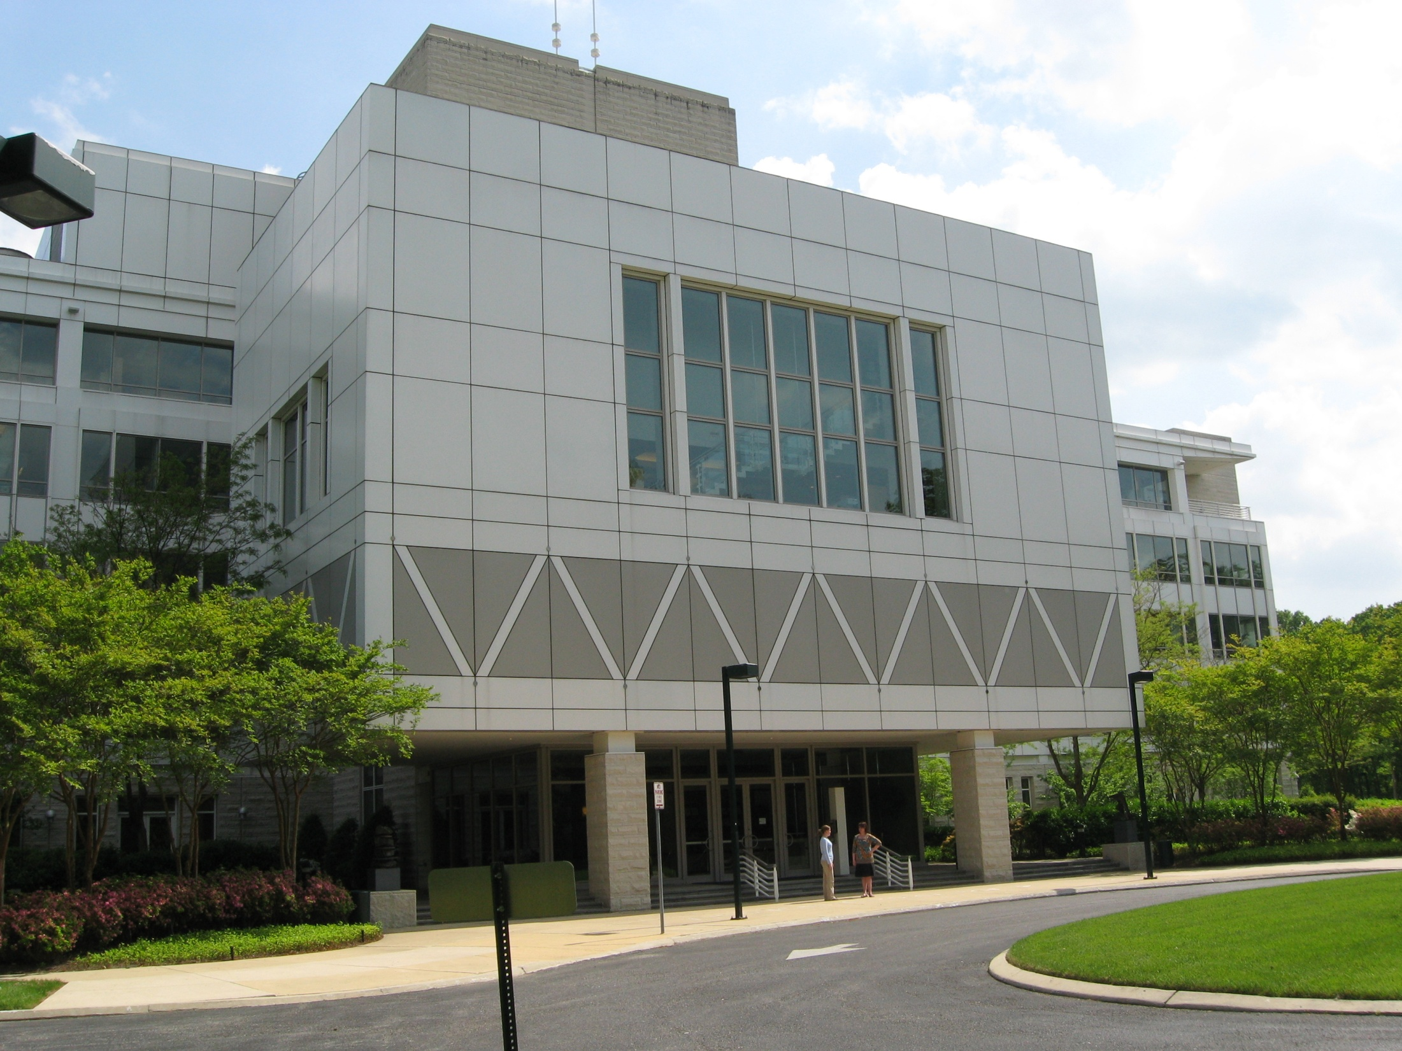

Amanda Nelson
Associate Archivist
Niels Bohr Library & Archives anelson@aip.org
In the Digital Age:
New Features for Online Transcripts

Slide 2
What we have
Over 1,500 interviews with physicists from 1960s to the present
2009-2013
  2 National Endowment for the Humanities (NEH) grants to place 1000 transcripts online
Usage
  Prior to online – 185 requests per year
  Once online – over 134,000 views per year

Slide 3
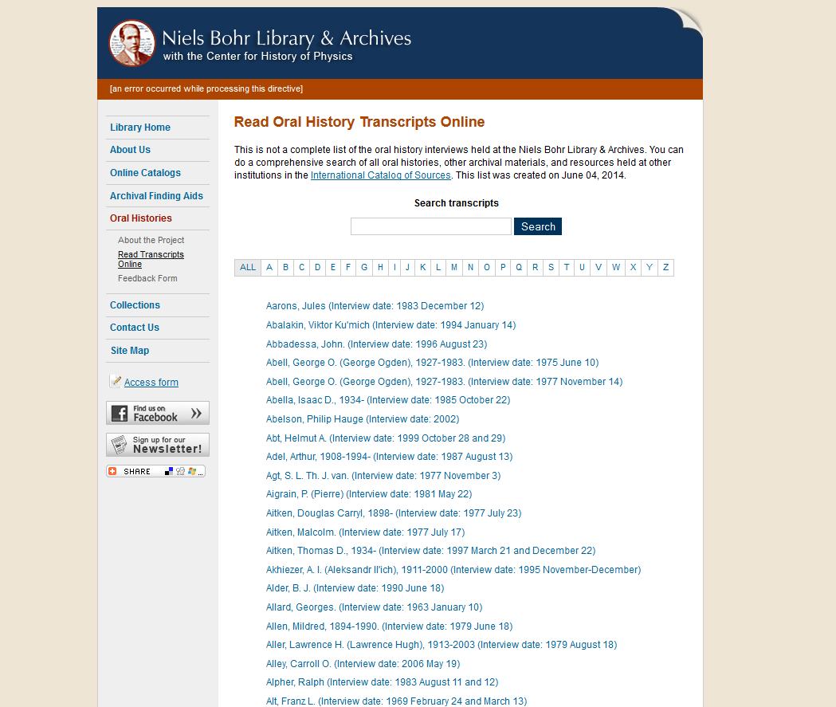
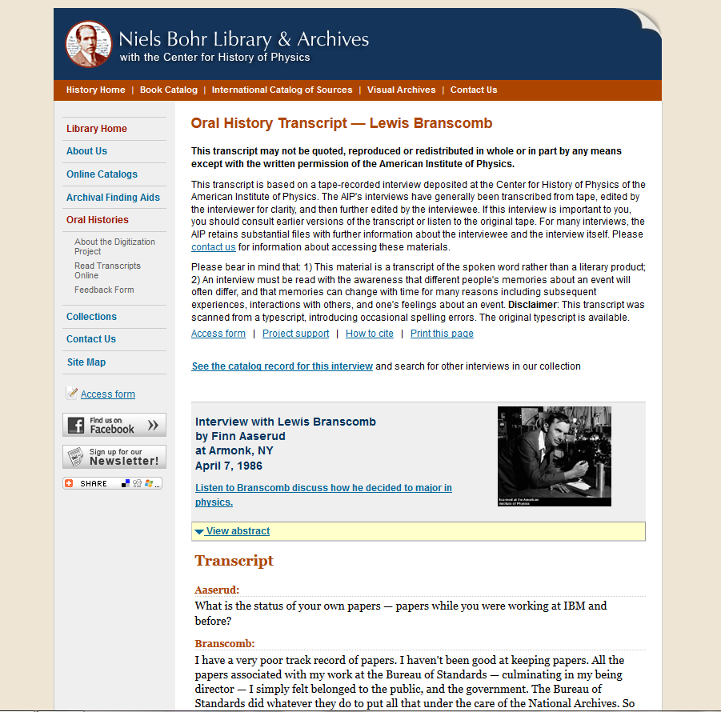
Current features
Landing page
  Name list of interview subjects
  Full-text search box
    Provided by Google
Transcripts
  Link to existing MARC record
  Audio clips
    Pop up audio player
  Picture copied from our Emilio Segrè Visual Archives (ESVA)
Everything is static

Slide 4
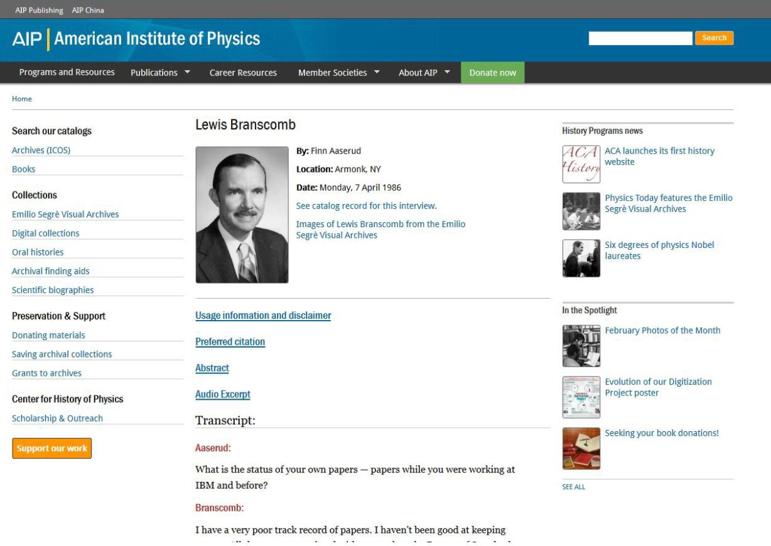
Moving to Drupal
In the process of creating a content type for our transcripts
Integrated
  Links directly to ESVA
  Keyword/subject tagging pulled from MARC records
  Embedded audio clips
  Right side bars specific for oral histories
Beginning migration within a few months

Slide 5
Amanda Nelson anelson@aip.org www.facebook.com/AIPhistory
@AIPhistory
Questions? Thoughts?
Contact me

