Slide 1
Archive Engine West Contextualizing Digital Objects with EAD Metadata
Jodi Allison-Bunnell, Orbis Cascade Alliance
Worthy Martin, Institute for Advanced Technology in the Humanities, University of Virginia
Society of American Archivists Annual Meeting
2014 August 14

Slide 2
About the Alliance and Northwest Digital Archives

Slide 3
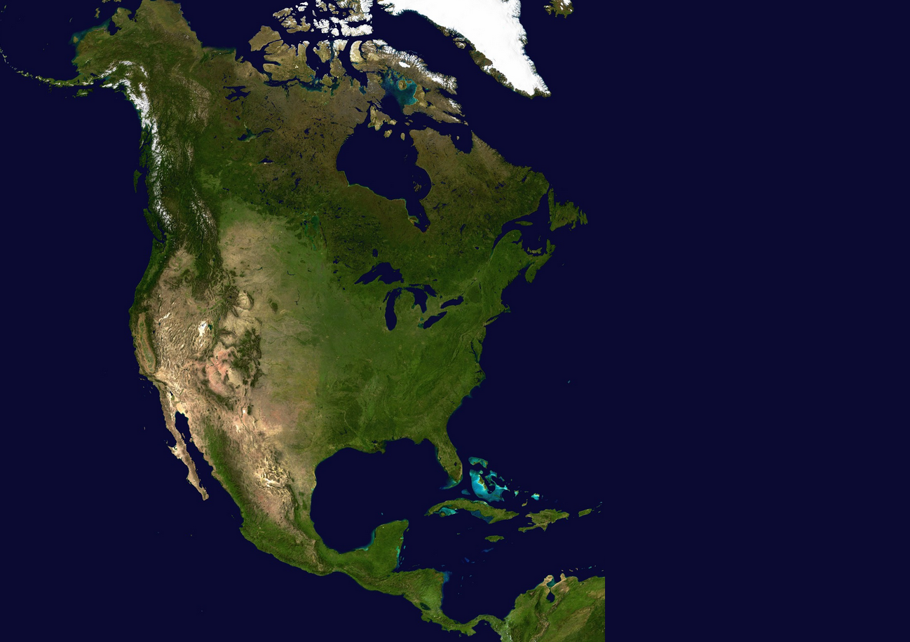
Orbis Cascade Alliance
Library Consortium for WA,OR,ID
Northwest Digital Archives (NWDA) Program with 40 members and 23,000 EAD finding aids
No shared digital repository
Shared ILS
Notes:
So that’s a little bit about the program.

Slide 4
Project Origins
Notes:
One of the origins of the project is a story that will be familiar to all of you.

Slide 5
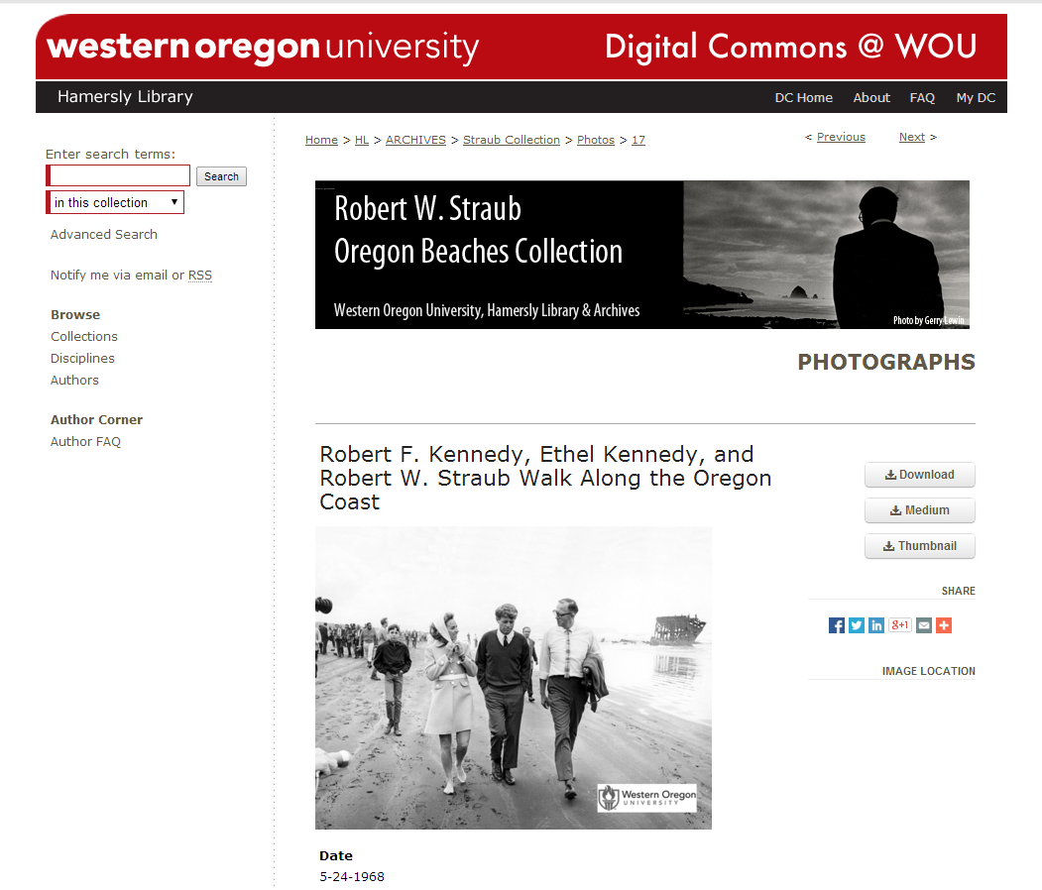
Notes:
Here’s an archival photograph that we’ve found in Western Oregon University’s IR of Robert F. Kennedy’s campaign trip to Oregon. This is good—it’s online, it has a description of the item.

Slide 6
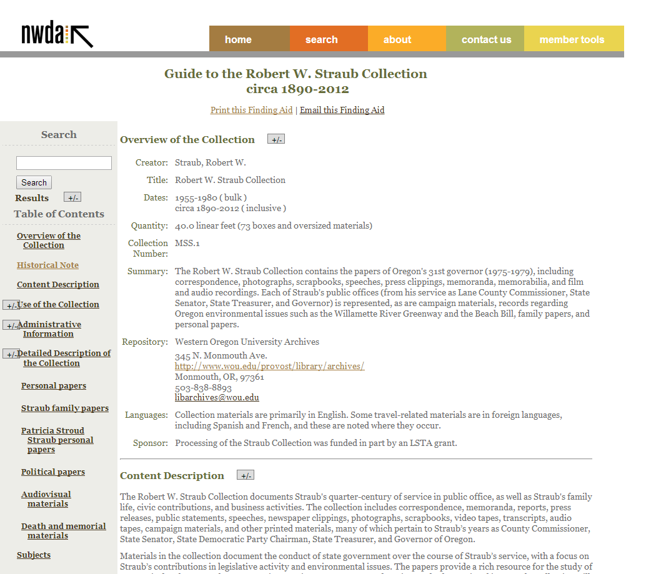
Notes:
But it’s from this collection, which has a collection-level description that includes important historical background and an overall content description. And that content description is particularly important because only a few items from this substantial collection are online.
Right now, the digital object doesn’t point to the finding aid, and the finding aid doesn’t point to the digital objects. The whole reason to have a finding aid is that each item is part of a collection, and that context is extremely important.
Yet we as a profession don’t have many good approaches to this problem. Digitized objects and finding aids are often produced through separate workflows and different teams of people, and end up in separate interfaces for the most part.
And while it’s perfectly possible to point these things at one another, what we end up with is related objects separated.

Slide 7
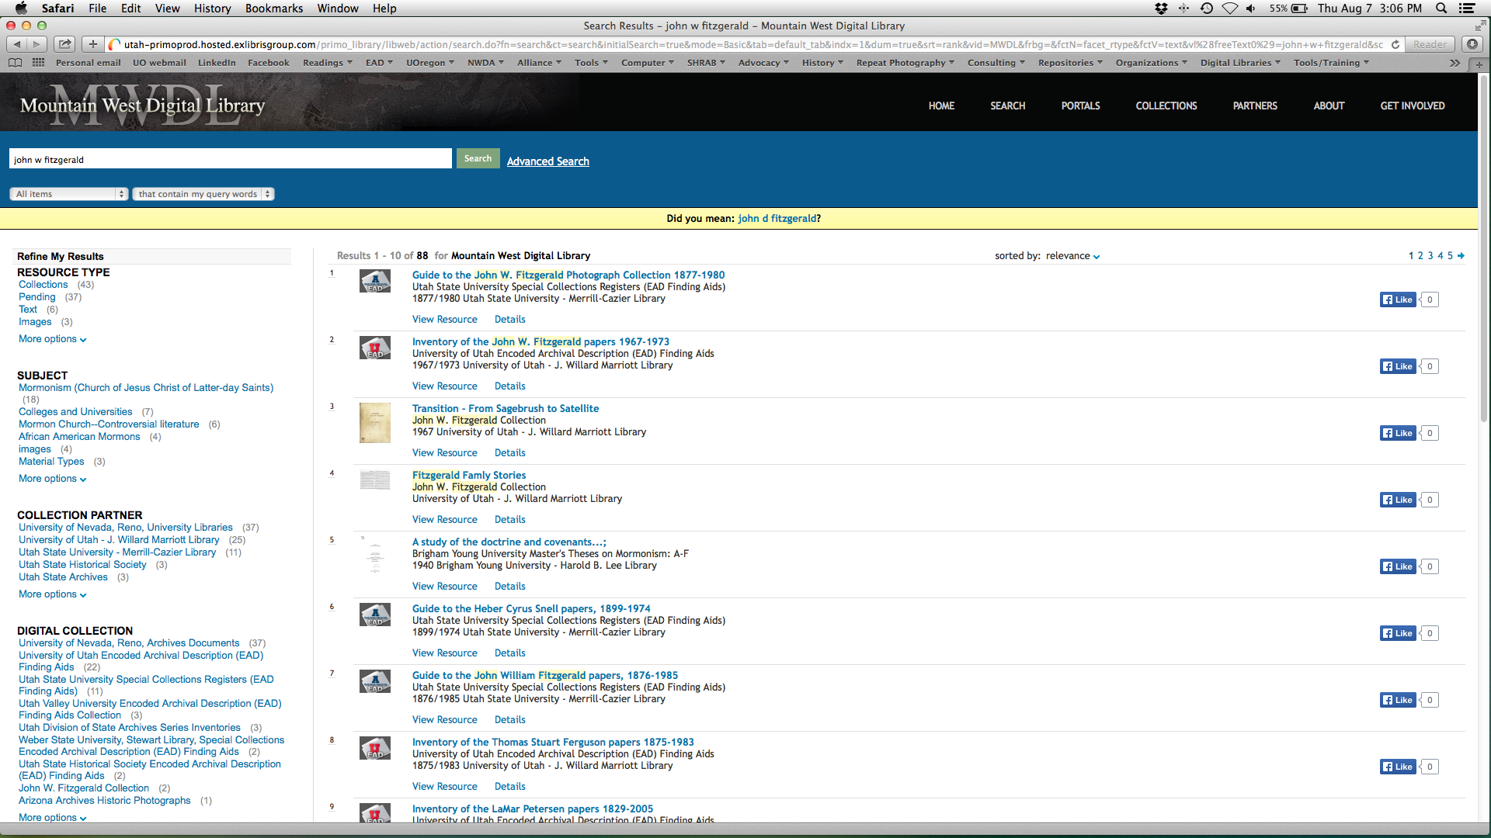
Notes:
And while we can build different means for discovery of finding aids and digital content together, this has some serious limitations for end users: There’s no way to tell in this Primo discovery layer that item 3 is from item 2. And it is.
So our current presentations of metadata don’t do much to overcome the inherent challenges of separate workflows and interfaces.

Slide 8
Research and Development
Researcher Needs Study with Beth Yakel 2008
IMLS Collaborative Planning Grant 2008-2009
Prototype development
Consortium program with EAD brings opportunities
IMLS National Leadership Grant 2011 for Demonstration project
Notes:
So we know this is a problem in the view of archivists; what do our users think?
In 2008, we had a planning grant for what was then called the Cross-Search and Context Utility. As part of that I had the pleasure of conducting the Researcher Needs study with Beth Yakel of the University of Michigan.
What we found in that study was that current presentations of both finding aids and digital content don’t meet core needs; subjects wanted combination of the best of both. It is clearly not enough to just put full finding aids on the screen and point to digital objects; we need to create more effective presentations that pull out the relevant parts of finding aids and present them with digital objects in a way that makes sense to end users unfamiliar with the bizarre things that finding aids are.
In addition, the consortium offers an outstanding opportunity; we have a large group of finding aids prepared under the same best practices and a diverse group of institutions. We don’t’ have a single repository for digital content, so it’s not easy either to aggregate our content or to work with it in other ways. And while many other state and regional consortia have a single repository, many don’t, so this was a chance to explore approaches that may work more broadly.
Receipt of an IMLS demonstration grant allowed us to build a demonstration project and begin to see how the prototype began to scale in a number of ways

Slide 9
Project Process
Notes:
Eight NWDA member institutions as project partners to facilitate user testing; partnership with the University of Virginia’s Institute for Advanced Technology in the Humanities; advisers Merrilee Profitt, Leigh Grinstead, and Bill Layman.

Slide 10
Development
Demonstration site
Built by IATH
Blacklight discovery on top of SOLR index
Association of EADs and associated CHOs
Automated association not possible; association by inspection
MODS records for each CHO
Heavy metadata wrangling
Notes:
Translation of CHO: Cultural heritage object
Explain “association by inspection”
And so we quickly found that making this work required heavy metadata wrangling.
That’s a little bit about our overall approach. For a little more on the “guts” of the project I’ll turn the podium over to Worthy.

Slide 11
Archival Contexts
CHO – base items to be presented in context
Collection – EAD level context
Repository – institutional context
Consortium – similarity context
Notes:
To reiterate –
Tenent1: people are interested in individual Cultural Heritage Objects
And then are interested in the context of those CHOs – what other CHOs in the collection
or in the repository
or in the same category

Slide 12
Accessing CHOs and Context
CHOs
present only base items with digital surrogates
object description
collection description (brief)
uniform preview
path to original repository record
path to repository description
Collection
long description
list of all CHO records in collection
path to original finding aid
path to repository description
Notes:
Tenent2: AEW only provides information about CHOs that it can provide some access to, i.e., only CHOs represented in digital collections
Uniform as possible presentation of individual CHO, collection and repository
But also access to original records

Slide 13
Accessing CHOs and Context
Repository
brief description
path to institutional home
list of all collections
Similarity
free text search in descriptions/titles
subject metadata
Notes:
Age old archive problem of uniformity of description and categorization – not solved here
But still interesting associations across repositories and collections.

Slide 14
Project Outcomes
Notes:
So, what did we get out of the project?
One of the most tangible things we got out of the project was the demonstration site, Archive Engine West. Let’s look at the basic functions of the site.

Slide 15
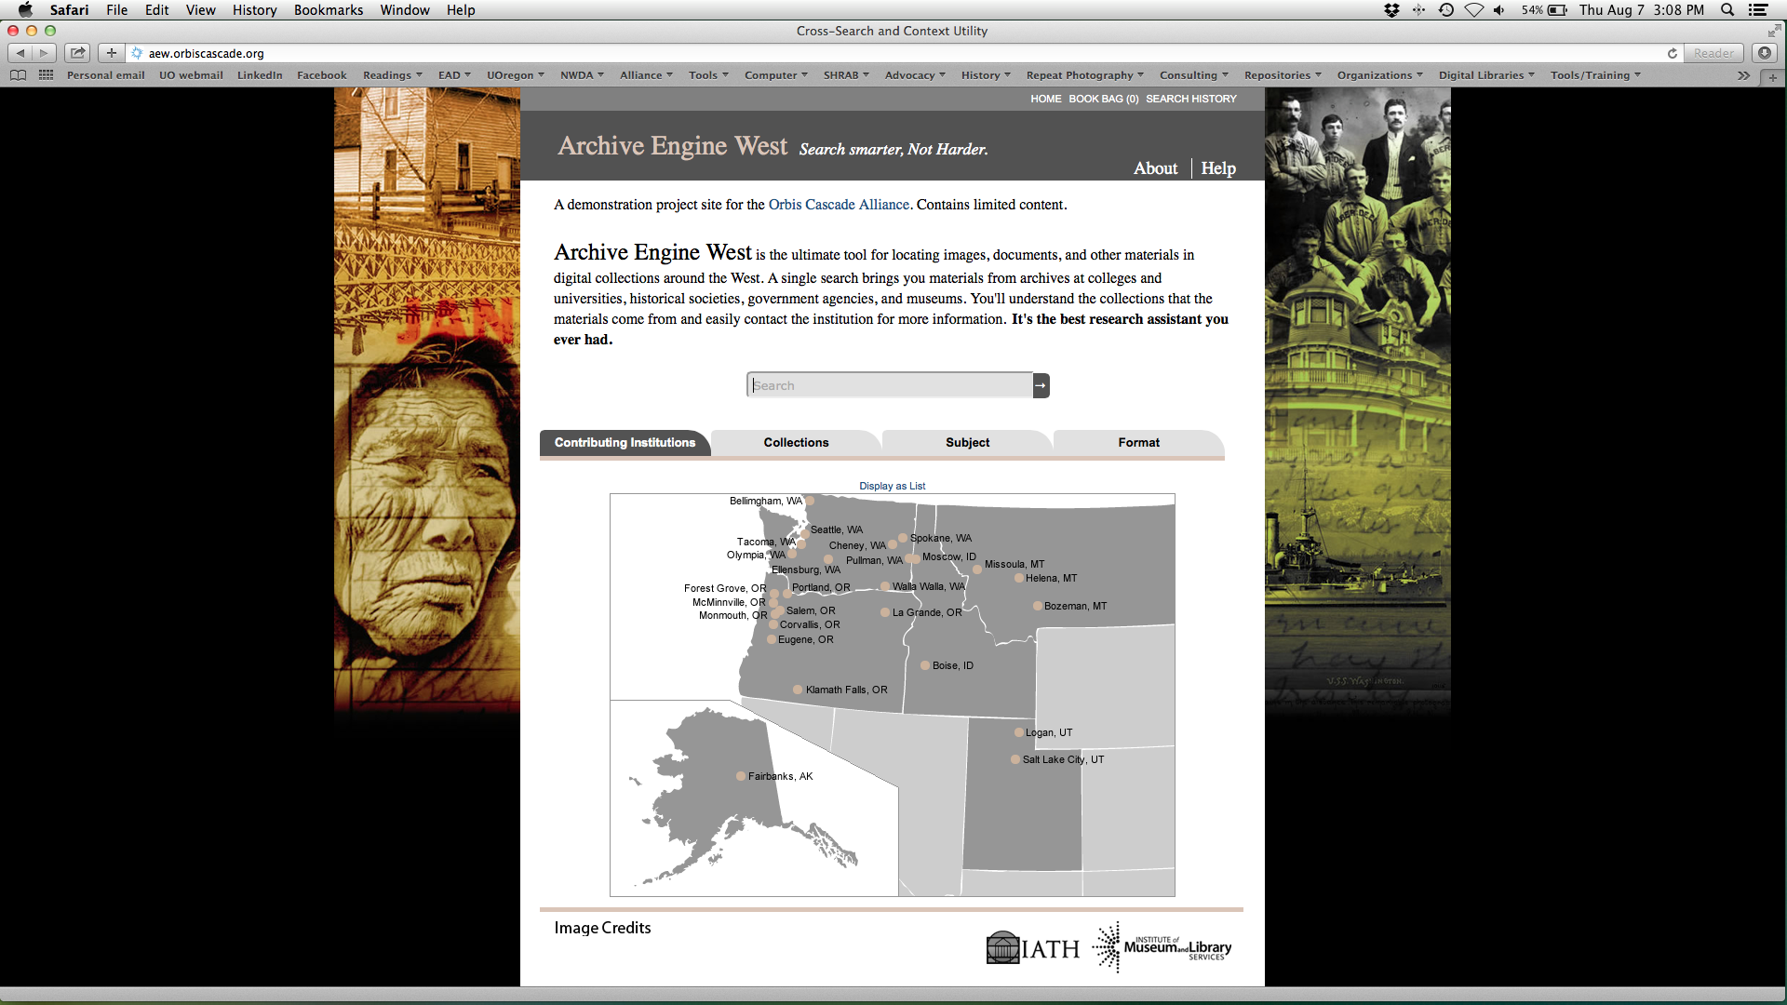
Notes:
Here’s the home page for what we named Archive Engine West.

Slide 16
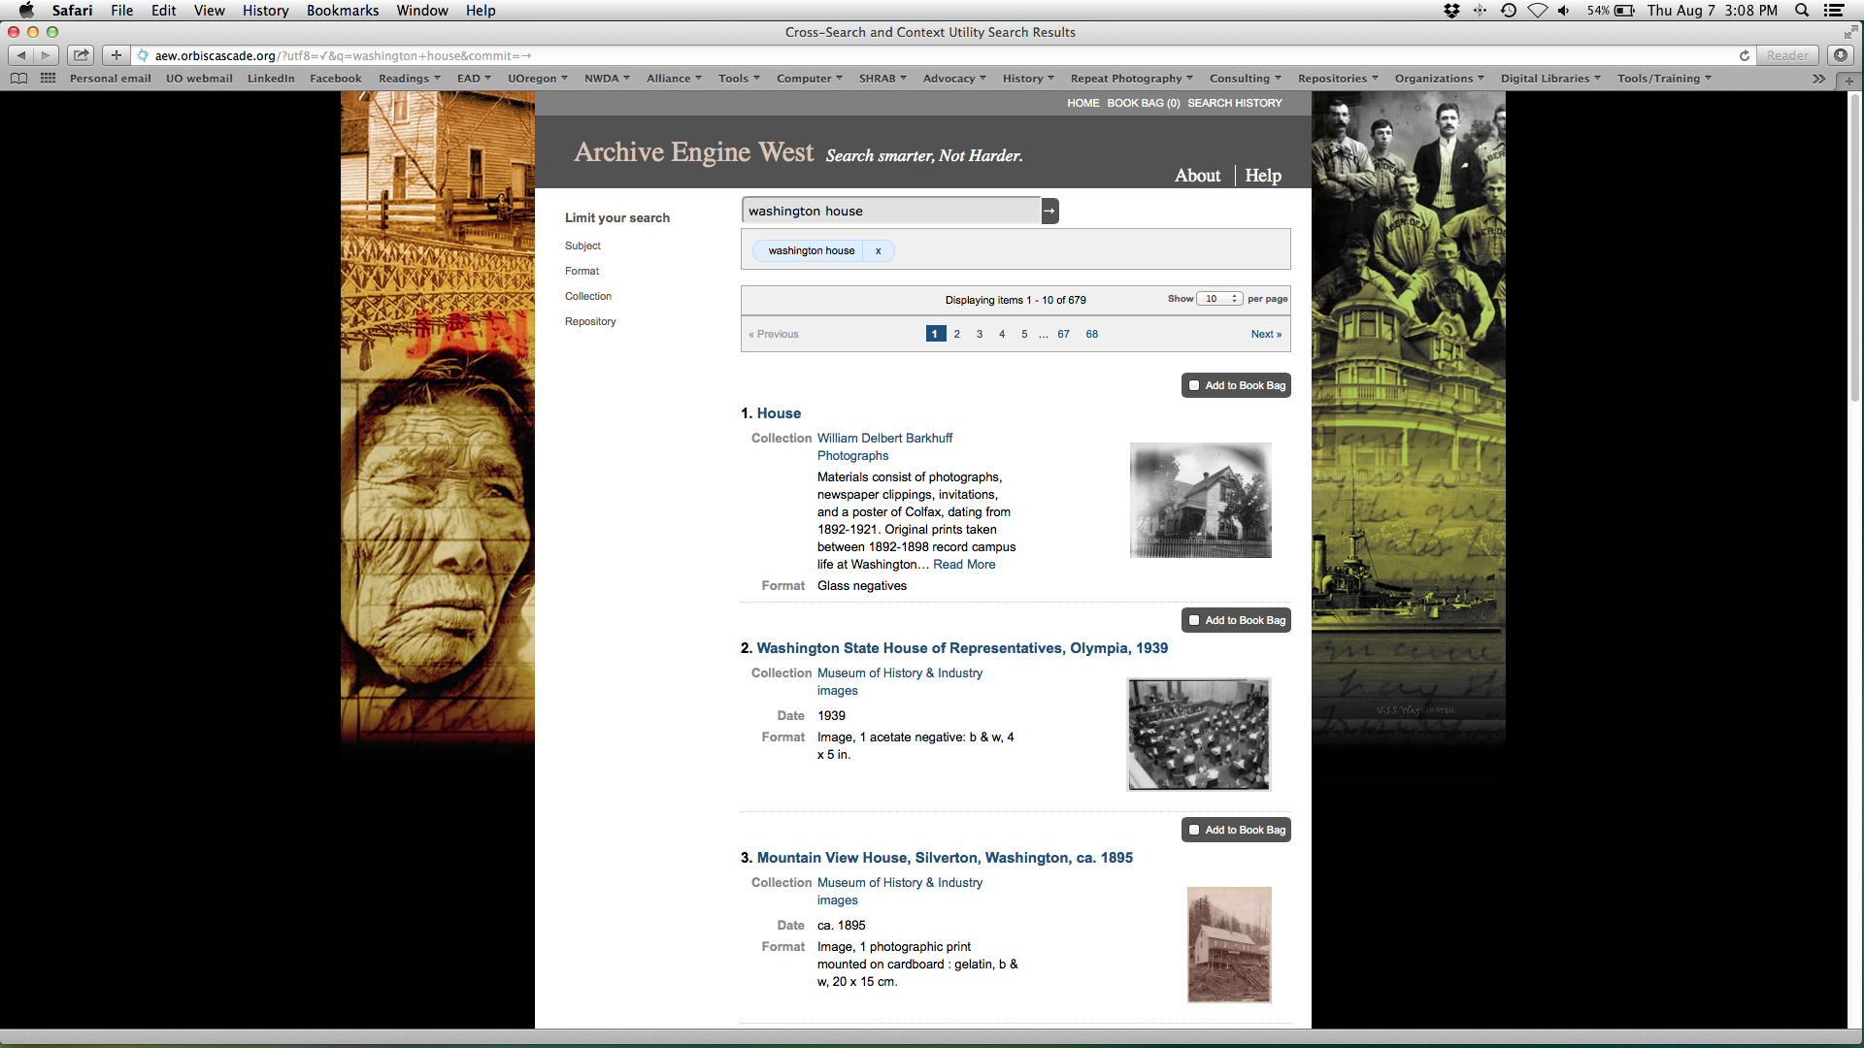
Notes:
And here are the search results for a simple search on Washington house.

Slide 17
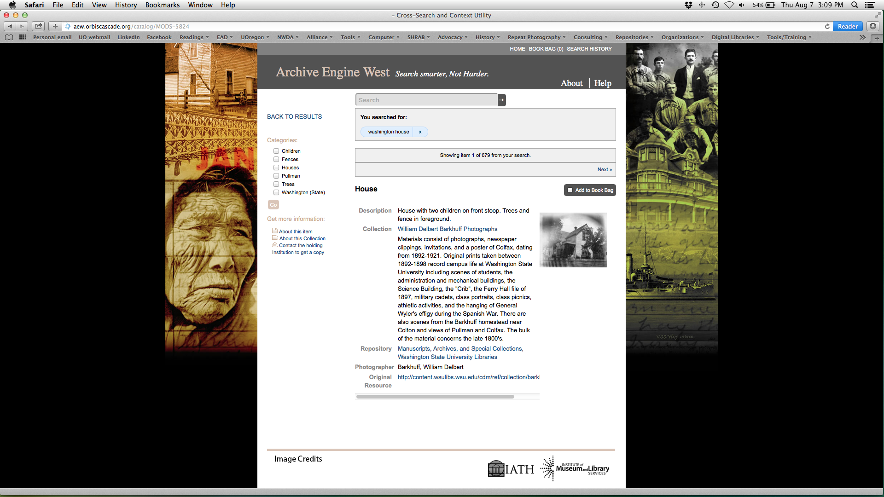
Item-Level
Collection-Level
Notes:
It’s in the item record that we start to see object in context: In this case, a thumbnail and item description, date, and format, plus the name of the collection and the collection scope and content note.

Slide 18
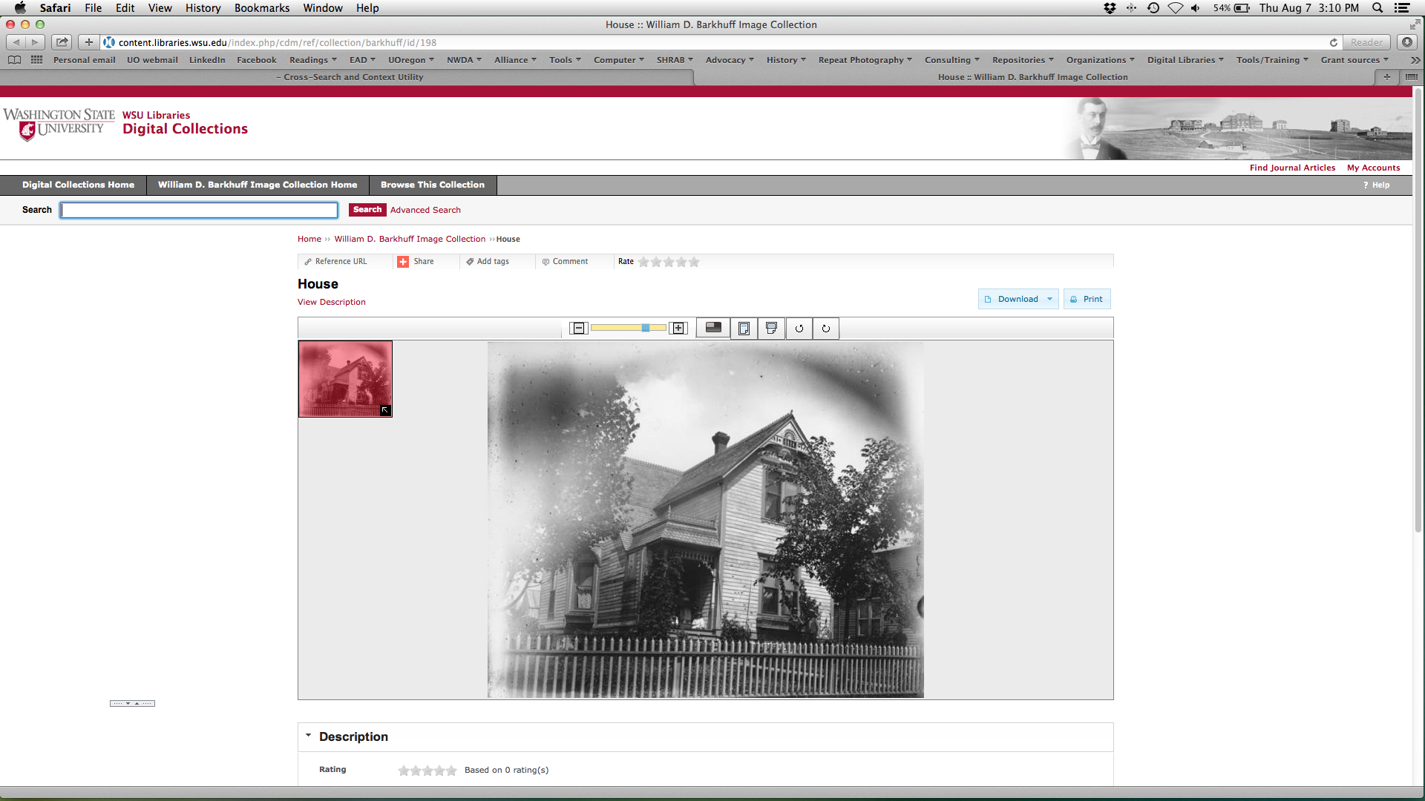
Notes:
You can get to the digital object where it’s originally hosted.

Slide 19
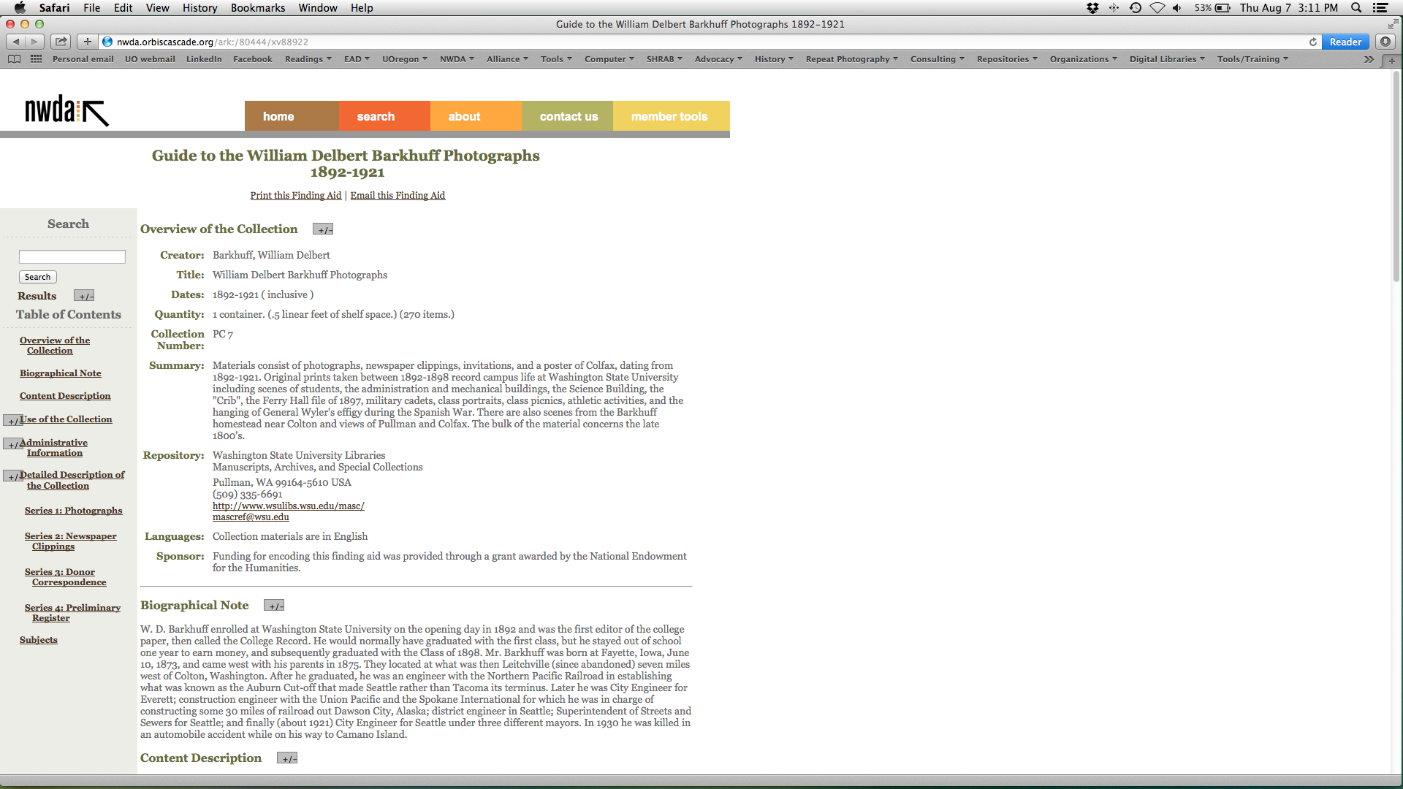
Notes:
You can get to the full finding aid if you want more information about the collection.

Slide 20
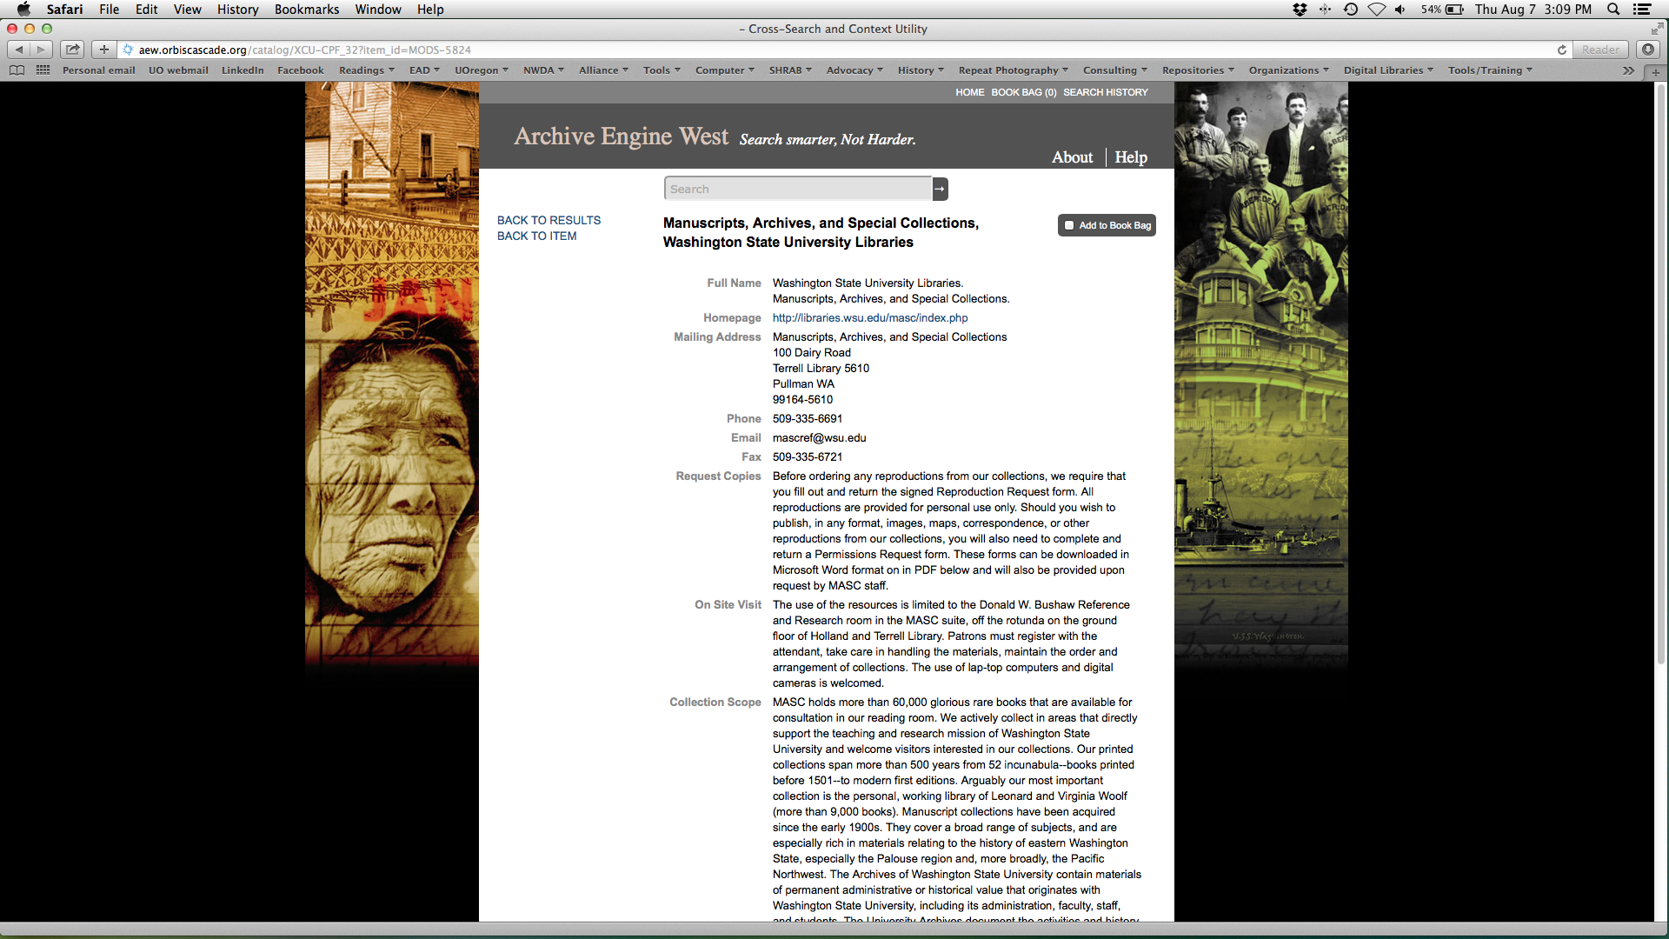
Notes:
You can get to a repository record that provides complete contact information for the holding institution.

Slide 21
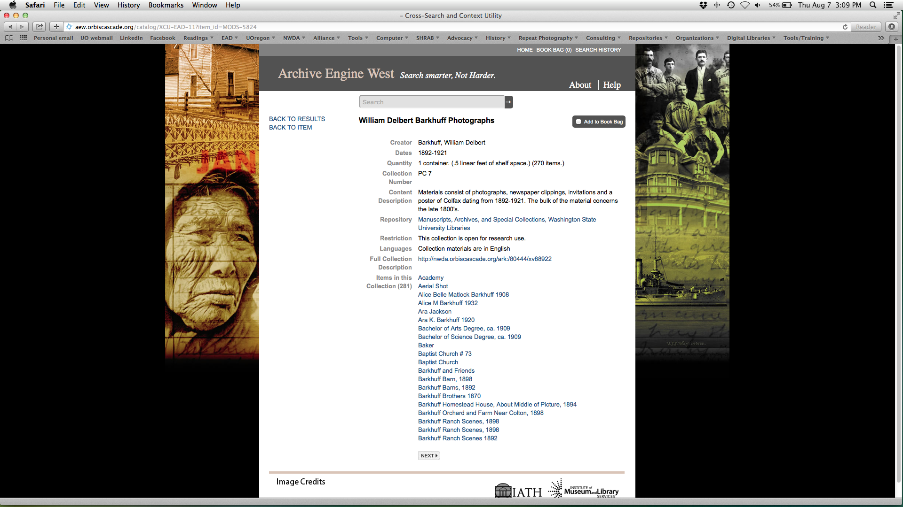
Notes:
And you can also get a sense of all the digital objects in the collection.
So in summary, the demonstration site relates digital objects to associated collection-level records in a single interface, links to the original objects, finding aids, and repository information, and relates the individual items to one another.

Slide 22
Summative Evaluation
Rockman et al
End user reactions:
Liked the site and found it useful for their research
Recognized and appreciated the contextual information presented with the digital objects
Able to complete the search tasks we gave them
Notes:
So how did this all come out? For users, our approach was quite successful, according to the summative evaluation of the demonstration site conducted by Rockman et al. They found that the end users they interviewed liked the site, found it useful, and were able to complete the tasks we gave them. Most importantly, they understood without being prompted the collection-level context and appreciated the approach.

Slide 23
Limitations
Deficiencies in ability to link EADs and CHOs
Best Practices deficit
Very inconsistent CHO metadata
No shared metadata standards
Notes:
The deficiencies were really on the back end—not in the infrastructure, but in our metadata.
We discovered that we have very little connection between EADs and CHOs. Our members have been able to make those linkages but in the absence of an effective interface for making use of them had largely not done so. There are serious deficiencies in our EAD standards in this area, which we are in the process of remedying.
Our digital content metadata was very inconsistent. Since we have no shared metadata standards, this is unsurprising, but it is an interesting demonstration of how many different ways there are to interpret the use of a “date” field. And those findings are not unique to our experience or to this project; the fields that gave us the most trouble are precisely the same ones that the Digital Public Library of America is wrestling with.
As a result it’s unsustainable in its current form.

Slide 24
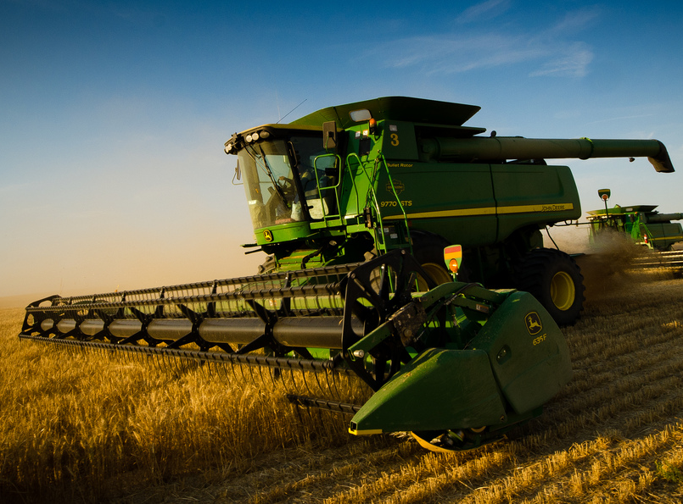
http://www.flickr.com/photos/dizmangphotography/9284617870
Notes:
What we want is this:
http://www.flickr.com/photos/dizmangphotography/9284617870

Slide 25
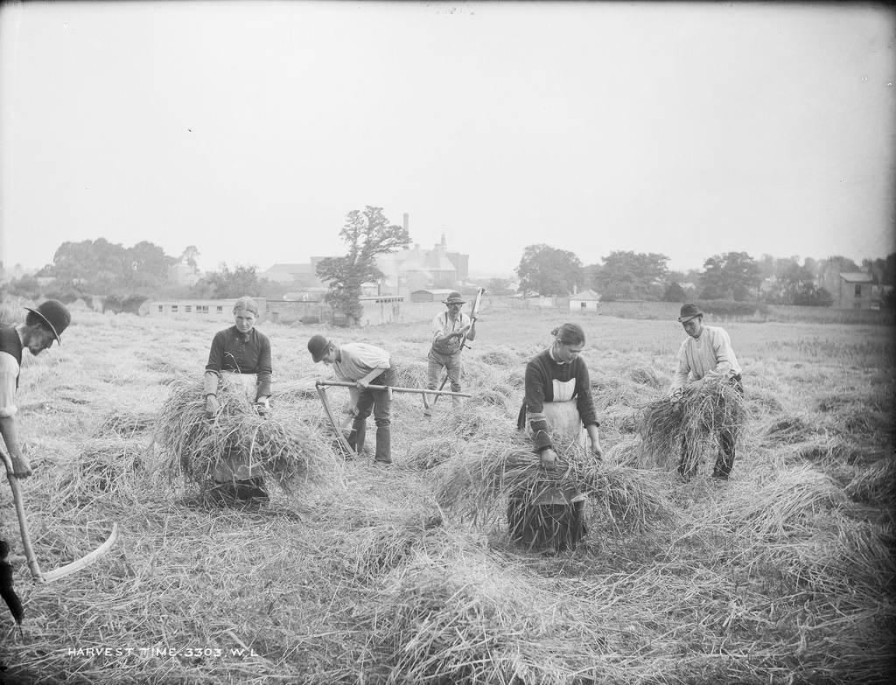
http://www.flickr.com/photos/nlireland/5984094240
Notes:
What we currently have is this:
http://www.flickr.com/photos/nlireland/5984094240

Slide 26
What’s Next?
Notes:
So we’ve got a good concept and a demonstration site. We know that we’re working on an important problem and made some significant progress. This demonstration project has demonstrated a great deal to us as an organization and, I hope, to others.
So what comes next?

Slide 27
Current Activities
Grant extension
Developing CHO metadata standards
Integration into new Strategic Agenda
Content Creation & Dissemination Program
Exploring DPLA Service Hub
Integration into redesign of EAD Researcher Site
AEW site sustainability?
Notes:
The grant is extended to the end of this calendar year.
That in turn gives us a great opportunity to integrate the discussion of this project into the Alliance’s new Strategic Agenda, which has created a new program devoted to unique materials, the Content Creation & Dissemination Program. That’s a pretty different approach: instead of being a silo’d special collections-focused program, we’ve got a broader focus on all the unique materials held by our members.
As part of that new program, we’re exploring becoming a Digital Public Library of America service hub and engaging in the national-level discussions about digital object metadata consistency that fine project is driving.
We were already planning and are now engaged in a substantial redesign of our EAD site. By integrating the repository registry from this project and vastly improving the connections we can make programmatically between finding aids and associated content we’re going to make good use of the knowledge gained on this projet.
What is to become of the AEW site? That is under review and is ultimately up to the governing council of the Alliance as they consider all of our program offerings for unique materials.

Slide 28
Summary
Importance of integrating EAD metadata and CHOs on large scale
Part of “whither EAD?”
Dependent on shared best practices for CHOs and EAD
Notes:
Where does this all take us?
Most important is the need to usefully integrate collection-level metadata and associated digital objects, and to do so on a large scale. It’s what our end users want and need. And our current options for discovery layers don’t yet do the job.
Ultimately I’ll suggest that if we’re not doing something like this with our EAD finding aids, we may as well not do EAD. It’s time to do something quite a bit more with all the structured metadata that we’ve spent so much time and resources creating.
I’d also suggest that we will continue to struggle with large-scale digitization without useful connections with collection-level metadata. It’s not surprising that the larger scale approaches to digitization—North Carolina, Archives of American Art, the demonstration projects funded by NHPRC—rely on integrated workflows between EAD and digital object creation and dissemination.
How can we make this happen on a larger scale? By having some base-level agreement on metadata standards for CHOs and EAD. DPLA is dong a great job driving the CHO conversations; with the future release of EAD3, groups associated with the EAD Roundtable are doing some work that should help us create some basic-level standards. Then we’ll be in a better place to make what needs to happen become a reality.

