Slide 1
Archives of Michigan
Electronic records preservation

Slide 2
PAT Project 2004 - 2006
NHPRC Grant to San Diego Supercomputer Center (SDSC)
Goal: Conduct case studies that test the ability to implement the SDSC’s Storage Resource Broker (SRB) data grid technology using a variety of archival collections.
Test a community model for electronic records management, with archival and technological functions practically and appropriately allocated in a distributed network.

Slide 3
Archives of Michigan: Preservation Case Study
Michigan Department of State, Bureau of Elections
Precinct Level Election Results
Paper Version
1835 - 2004
Database Version
1972 – 2004
Goal: Enable access to 30+ years worth of electronic elections data and preserve it for the future.

Slide 4
Michigan’s Elections Structure
Decentralized Administration
City Clerks (274)
Village Clerks (271)
Township Clerks (1,242)
Precinct maps are created and maintained by local clerks
Vote counts are sent to the Bureau of Elections

Slide 5
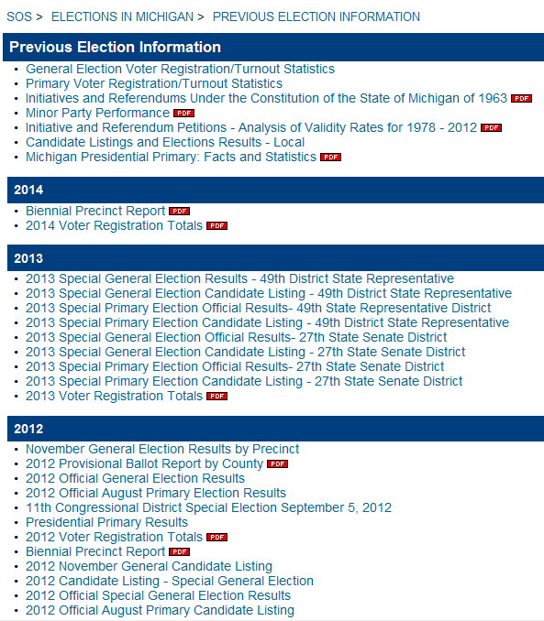
Currently, election results dating back to 1996 are available online. At one point in time, results were available online dating back to 1994.

Slide 6
Data Transfer
2001
21 open reel magnetic tapes (1972 – 1992)
3 floppy disks (1992 – 1996)
2 compact discs (1998 – 2000)*
*Mainframe was used until 1998
2003
1 compact disc (2002)
2005
1 compact disc (2004)
2007
1 compact disc (2006)
2009
1 compact disc (2008)
2011
1 compact disc (2010)
2013
1 compact disc (2012)

Slide 7
Other Custodians
University of Michigan, Inter-University Consortium for Political and Social Research (ICPSR)
1972 general election
1974 general election
1978 primary election
1978 general election
Michigan Center for Geographic Information
1984 – present
Michigan Manual (publication)
county level data

Slide 8
Michigan’s Appraisal Questions
What value do the ER have if the paper is already preserved?
If the Department of State, Bureau of Elections makes the records available electronically, why does the Archives of Michigan need to do it?
Will researchers use the data?

Slide 9
Step #1: Data Recovery
Michigan Department of Community Health magnetic tape machine → broke
Muller Media ~ $50 per tape (completed September 2005)
Load data into the Storage Resource Broker (SRB)
Replicate data on Michigan grid brick and 2 SDSC grid bricks

Slide 10
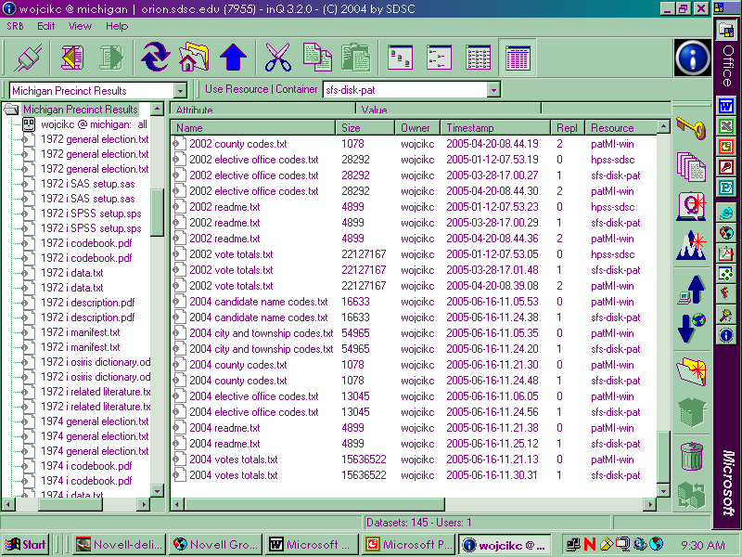

Slide 11
Step #2: Creating Usable Data
Work backwards: start with the most recent data first
SDSC loaded a copy of the data into a search interface (mimics the Bureau of Elections)
SDSC mapped the data to the codes in the metadata files to translate the data into meaningful information
SDSC validated the data and recorded anomalies
Data errors were compared with the paper records

Slide 12
Data Before

Slide 13
Data After

Slide 14
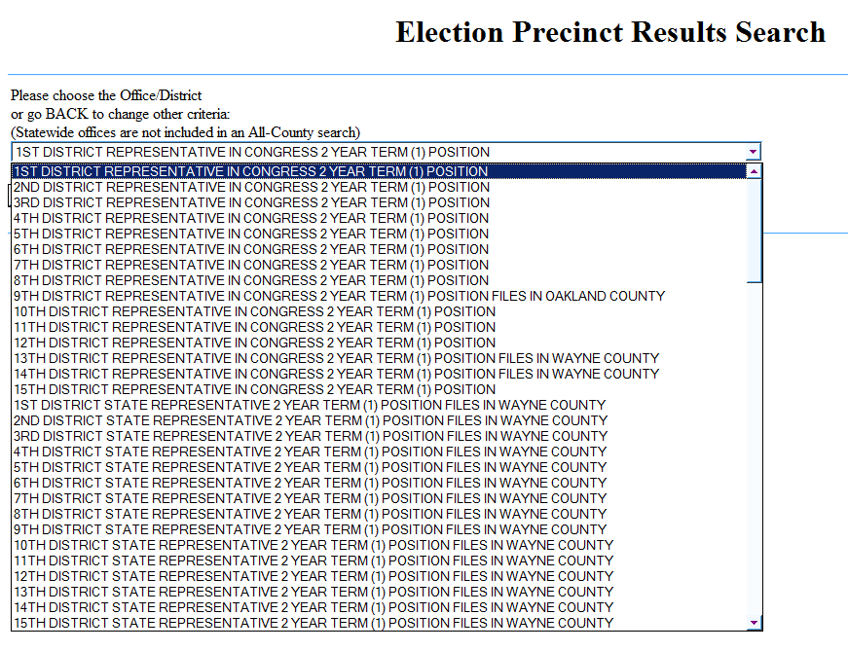

Slide 15
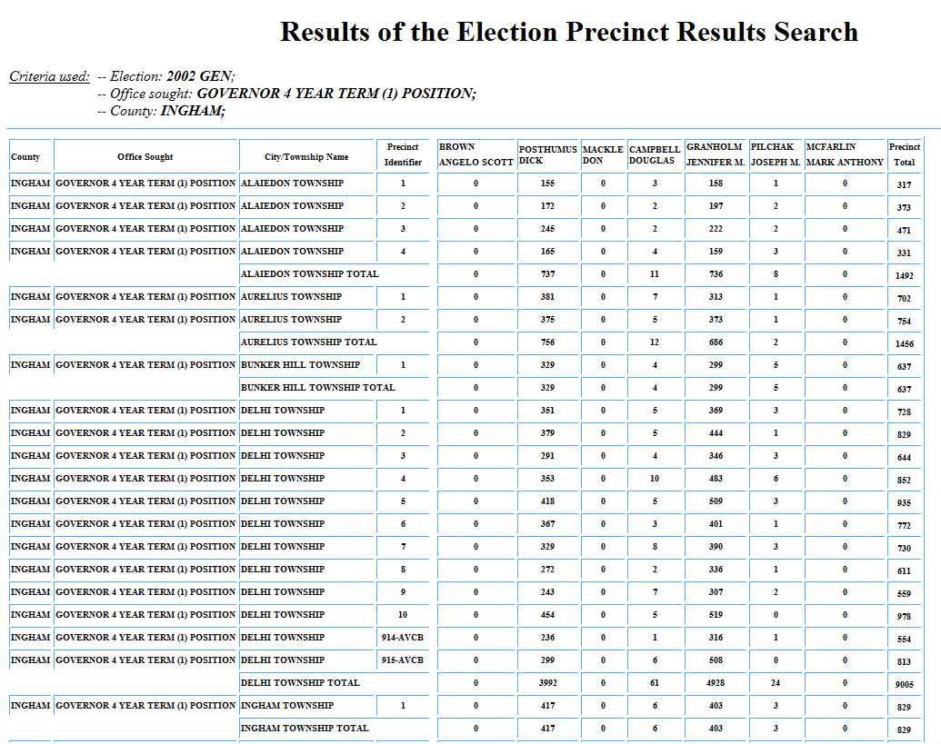

Slide 16
The 1998-2004 databases had a different layout than the 1992-1996 databases. SDSC had to resolve these differences so all of the databases could be loaded into the same search interface.
Original data
Clean the
data
Delete duplicate data
Make the 1992, 1994, and
1996 data format consistent
Address
anomalies
Solve duplicate key problem
Fix Detroit AVCB code problem
Map the
data
Use codes and vote total files to
produce 7 files like 1998 data
New data

Slide 17
1972-1990 Data
Code files that are needed to translate the data could not be located.
Determined it was not cost-effective to manually translate the data.
Decided to post the original code files online, in case a researcher wants to work with the raw data codes.

Slide 18
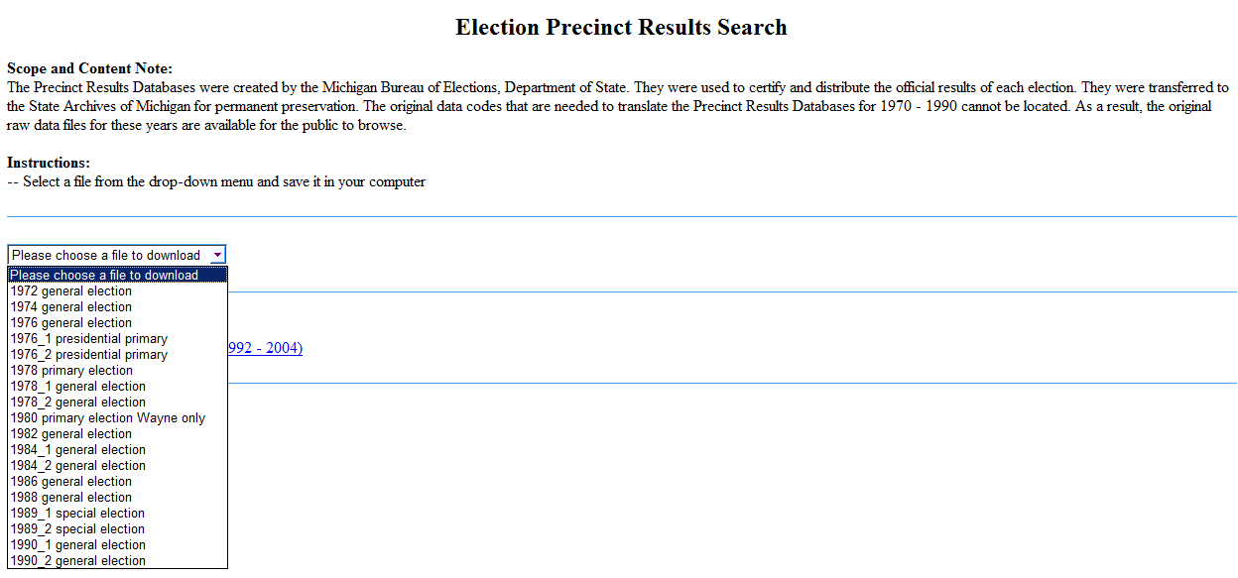

Slide 19
Step #3: GIS Interface
Create statewide maps displaying the county level election results for each general election
Identify blue and red counties for each race
Identify voting trends
SDSC mapped the data to geographic polygons supplied by CGI
Races: President, Governor, US Senate, Secretary of State, Attorney General

Slide 20
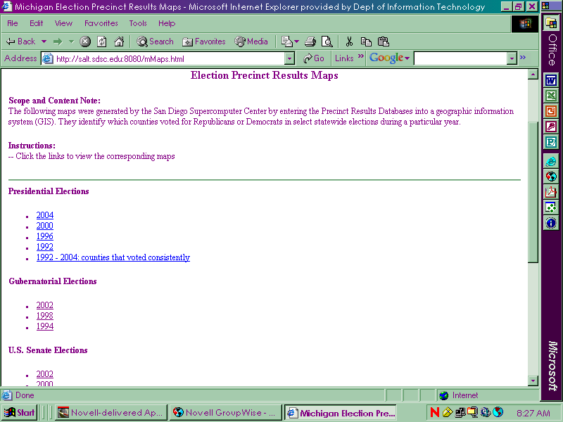

Slide 21
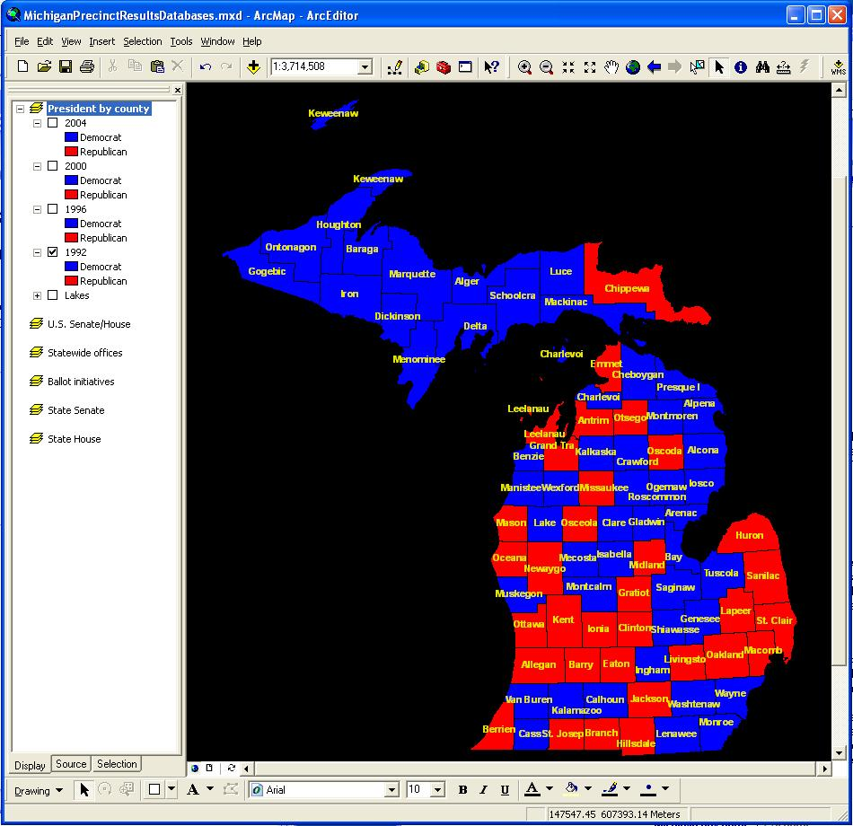

Slide 22
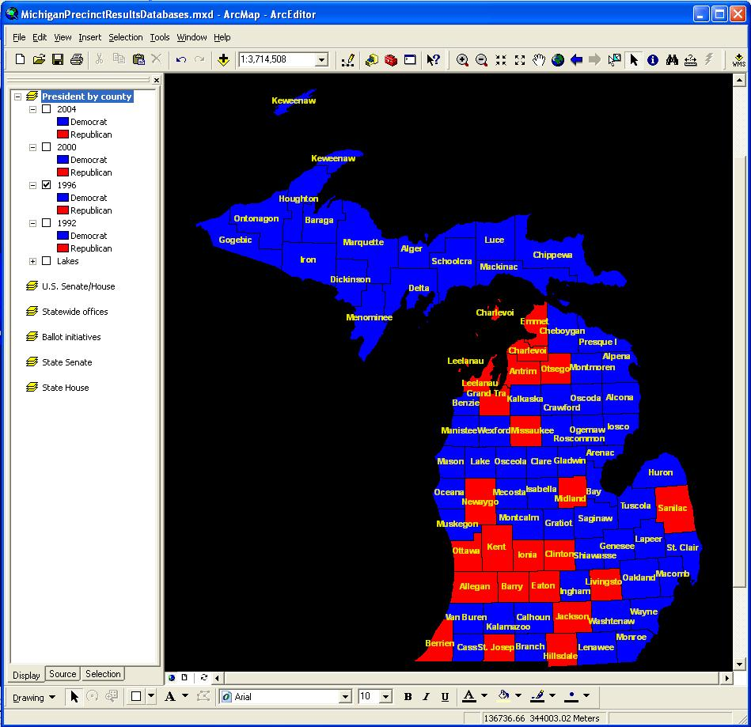

Slide 23
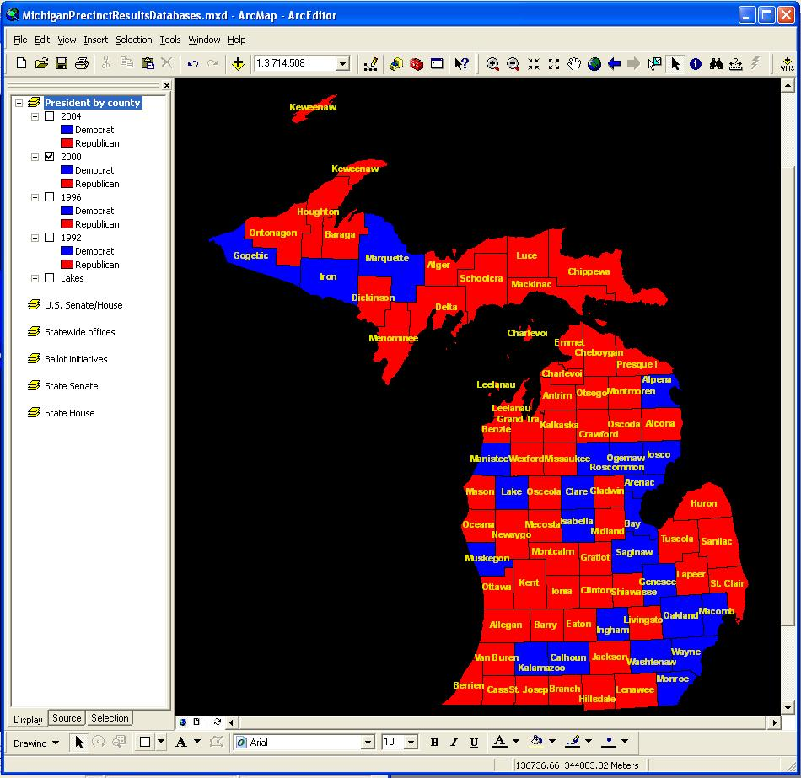

Slide 24
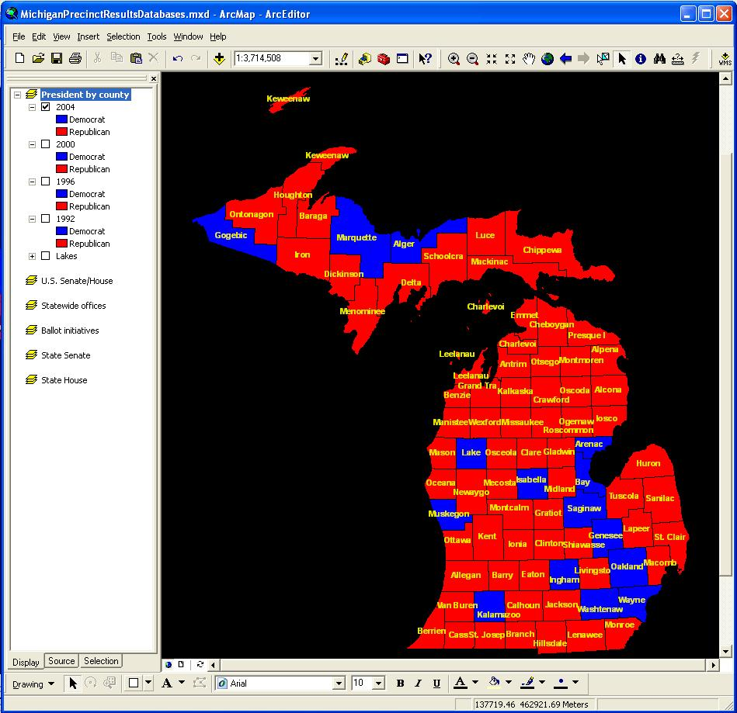

Slide 25
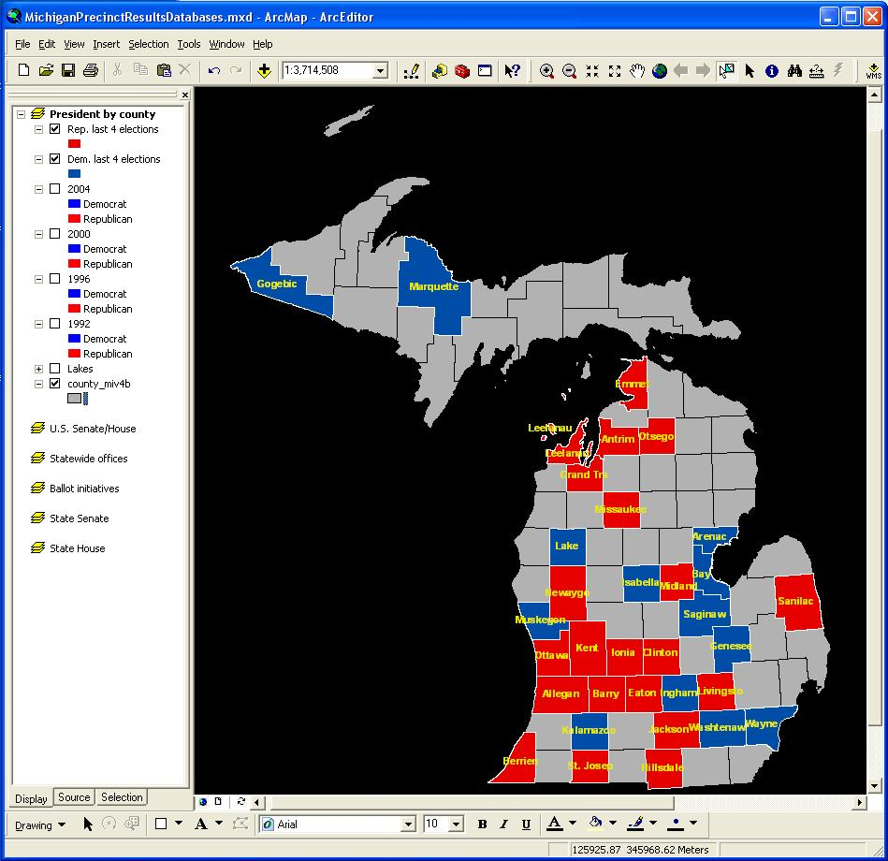

Slide 26
Lessons Learned
A formal submission agreement would have better documented the records upon accessioning
Accessioning ER shortly after they are created protects the records from loss and media problems
Avoid reactive appraisal—have a plan
Data may be recoverable from obsolete media
Metadata is essential for data translation

Slide 27
Caryn Wojcik
State of Michigan
Records Management Services
(517) 335-8222
Wojcikc@michigan.gov
http://www.michigan.gov/archivesofmi

