Slide 1
Digital Preservation - Its all about the metadata right?
Mark Evans – Director of Digital Archives
History Associates Incorporated
“Metadata and Digital Preservation: How Much Do We Really Need?”
SAA 2014 Panel Saturday, August 16, 8:30-9:45am

Slide 2
Agenda
Why metadata is important
Metadata landscape in digital preservation
Guiding efforts and standards
Contrasting approaches

Slide 3
Why is Metadata Important?
101101001000101010100001111100100101001001000101
010101010000111100101001011011100000111101110110
101101001000101010100001111100100101001001000101
010101010000111100101001011011100000111101110110
010101000001111100111111001111110011110001100011
101101001000101010100001111100100101001001000101
010101010000111100101001011011100000111101110110
A binary sequence is meaningless by itself
Metadata enables the information to be discovered and accessed
Metadata informs future preservation actions to ensure
continued access

Slide 4
The Big Question
What metadata is necessary to preserve digital objects so that they remain accessible and authentic over time?

Slide 5
Metadata Landscape
Descriptive
Access
Structural
Technical
Preservation
Administrative

Slide 6
We have Some Guidance
Open Archival Information System (OAIS) Reference Model
Interpreted
using its
Yields
Data Object
10010110100111001110
Representation Information
Information Object
Information necessary to render and understand the bit
sequences constituting the digital object.

Slide 7
OAIS Information Model
Information Objects
Descriptive Information
Content Information
Preservation Descriptive Information
Provenance
Context
Reference (Identity)
Fixity
10101
01010
10101
11001
10101
01010
10101
11001
Packaging Information
Each Information Object has associated representation information
Notes:
Representation Information: information necessary to render and understand the bit
sequences constituting the archived digital object.
• Preservation Description Information: information that supports and documents thepreservation of the archived object, including:
Reference information: uniquely identifies the archived object;
Context information: describes the archived object’s relationship(s) to other objects;
Provenance information: documents the history of the archived object;
Fixity information: validates the authenticity or integrity of the archived object.
• Packaging Information: information that binds all components of an information package into a single logical unit.
• Descriptive Information: information that supports the discovery and retrieval of the archived object by the repository’s users.

Slide 8
Examples of Object Metadata
Binary Sequence
11111111 11011000 11111111 11100000 00000000
00010000 01001010 01000110 01001001 01000110
Identity
FileName = HF2653.pdf
UUID = f81d4fae-7dec-11d0-a765-00a0c91e6bf6
File Format
PDF v1.4 Portable Document Format
Environment
Operating System = Windows v7.1
Application = Adobe Acrobat 12
Technical Properties
Size = 25654 bytes,
Number of pages = 3
Number of images = 2
Valid = True
Well Formed = true
Fixity
SHA1=2323A563DF4329DA234E1234
Provenance
Created = 10/5/2011,
Creating Application = Microsoft Office 2010
Last Modified = 8/12/2014

Slide 9
Beyond the Needs of Objects
What metadata enabling functions does a digital preservation system need?
Understand structural Information:
Hierarchy of both records and files
Relationships between Records
Relationships between files
Relationships between Records & Files
Technology-dependent information:
Determine if preservation actions are needed (e.g., obsolete format)
Technology-independent information:
Verify preservation actions were performed
Maintain provenance of all entities

Slide 10
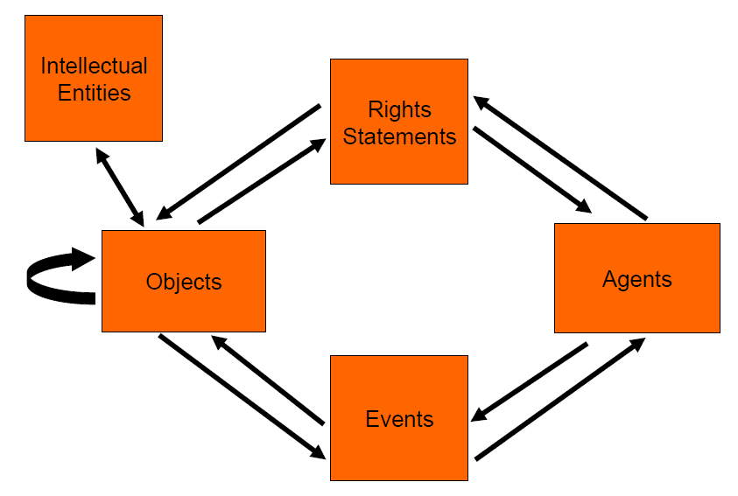
We Have Some More Guidance
PREMIS – Preservation Metadata Implementation Strategies
Rights
Assertions of one or more rights or permissions pertaining to an Object and/or Agent.
A data dictionary that defines a set of semantic units for capturing preservation metadata
First developed in 2005, latest version is 2.3
Agent
Person, organization, or software program/system
associated with Events in the life of an Object, or with Rights attached to an Object.
Object
Discreet unit of information in digital form.
Three types
File
Bitstream
Representation
Events
An action that involves or impacts at least one Object or Agent known by the system

Slide 11
PREMIS – Examples
Objects Entity
Object identifier
Preservation level
Significant characteristics
Object characteristics
fixity
format
size
creating application
inhibitors
object characteristics extension
Original name
Storage
Environment
software
hardware
Digital signatures
Relationships
Linking event identifier
Linking rights statement identifier
Event Entity
Event identifier
Event type (e.g. capture, creation, validation, migration, fixity check, ingestion)
Event dateTime
Event detail
Event outcome
Event outcome detail
Linking agent identifier
Linking object identifier

Slide 12
PREMIS – Conformance
A current “Hot Topic”
PREMIS is implementation neutral (“What” not “How”)
A PREMIS semantic unit can be recorded in any way a repository finds convenient:
Using an alternative name
As a single metadata element or a set of metadata elements
Implicit recording but must be recoverable
Capturing additional levels of detail
Conformance is Important. Especially for:
Exchange of digital objects between repositories
Use of shared technical registries
Use of automated metadata extraction tools

Slide 13
Don’t Forget Access and Management Needs
Digital Preservation system must also support
Application and enforcement of access and rights restrictions
Maintaining descriptive metadata with appropriate entity and level in the hierarchy
Ability for users to search on metadata
Ability for users to view metadata
Ability for users to add / edit metadata

Slide 14
What About Other Standards?
Lots of existing standards for a variety of uses / content types
Organization may have adopted / obligated to use particular standard
Metadata may already exist in a particular standard

Slide 15
Dealing with Diversity
A typical digital preservation system may have to deal with lots of ingest sources
Each ingest source potentially contains metadata
Can be in addition to or embedded within a digital object (or both)
Unlikely to be a consistent scheme across sources
Could be content specific
Could be standards based
Could be custom
Ingest sources unlikely to contain sufficient preservation metadata
Hopefully this will not be the case in the future
Today this is typically extracted and generated at ingest

Slide 16
Two Approaches
Convert or crosswalk existing metadata to a normalized form (Or force a standard on the creators)
Source /
Schema 1
Ingest
Source /
Schema 2
Convert to common Schema
OAIS
Digital Archive
Source /
Schema 3
Extract / Create
Preservation Metadata
Notes:
This would reduce the problem
However, combined schema may change over time:
Potential for subsequent conversions
Or cope with multiple versions
May require software changes
Also, each conversion is a potential point of loss
Adopted archival schema may not provide full coverage for source
E.g EAD arrives and DC is the adopted schema

Slide 17
Two Approaches cont..
Embed source metadata into a fixed schema that
Can represent structure
Can understand preservation metadata
Can embed metadata for any entity
Source /
Schema 1
Ingest
Source /
Schema 2
Embed within a fixed schema
OAIS
Digital Archive
Source /
Schema 3
Extract / Create
Preservation Metadata
Notes:
Define schema that:
Understands structural information
Understands technical information eg PREMIS
Embeds any descriptive metadata
Embeds any additional technical metadata eg MIX
Can embed multiple metadata schema for each entity
Schema supports standard OAIS functions:
Ingest, Access, Data Management, Storage
Controls Preservation
No metadata data loss

Slide 18
Conclusions
Metadata is the mechanism that enables access and preservation
OAIS and PREMIS provide great guidance for digital content
Provides a degree of freedom for implementation
Not a one size fits all approach
The next presentations will illustrate this

Slide 19
Thank you for your attention
Mark Evans
mevans@historyassociates.com
http://www.historyassociates.com

