Slide 1
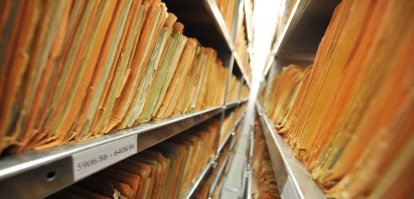
Surveillance, Documentation and Privacy
Case Studies in Records Disposition
Joel A. Blanco-Rivera
Katherine M. Wisser
August 13, 2013

Slide 2
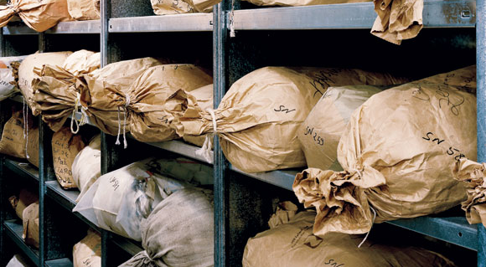
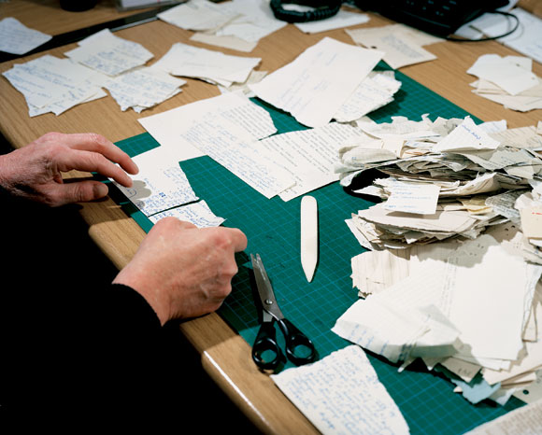
Introduction: The Stasi Model
Photos: Daniel Stier
Wired Magazine, Issue 16.02

Slide 3
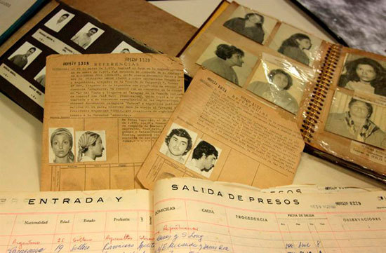
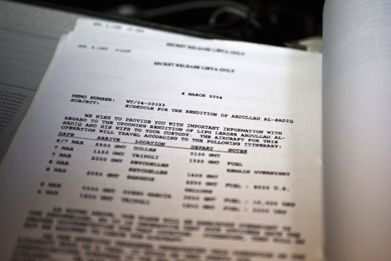
Research Question
How archives deal with the disposition, access and preservation of surveillance files?

Slide 4
Definitions
Surveillance: A collective activity under a single overriding agency to gather information about an individual through governmental and non-governmental sources.
Surveillance file: the collective intelligence and interpretation of the information gathered.
Privacy: The ability to live life not watched.

Slide 5
Definitions
Access: the degree to which a file is available for review.
Access – unfettered, complete access to all files from a regime on individuals.
Access – fettered: ranges from more open to less open. The spectrum depended on who, what is redacted and how much is redacted. This also leads to questions of who is doing the limiting and what they are limiting.
No access – Files are closed (for whatever reason)
No access – Files are undisclosed or destroyed

Slide 6
Methodology
Comparative case study
Selection of countries
Data collection and analysis
Country | Intelligence Agency | Years | Current disposition | Access

Slide 7
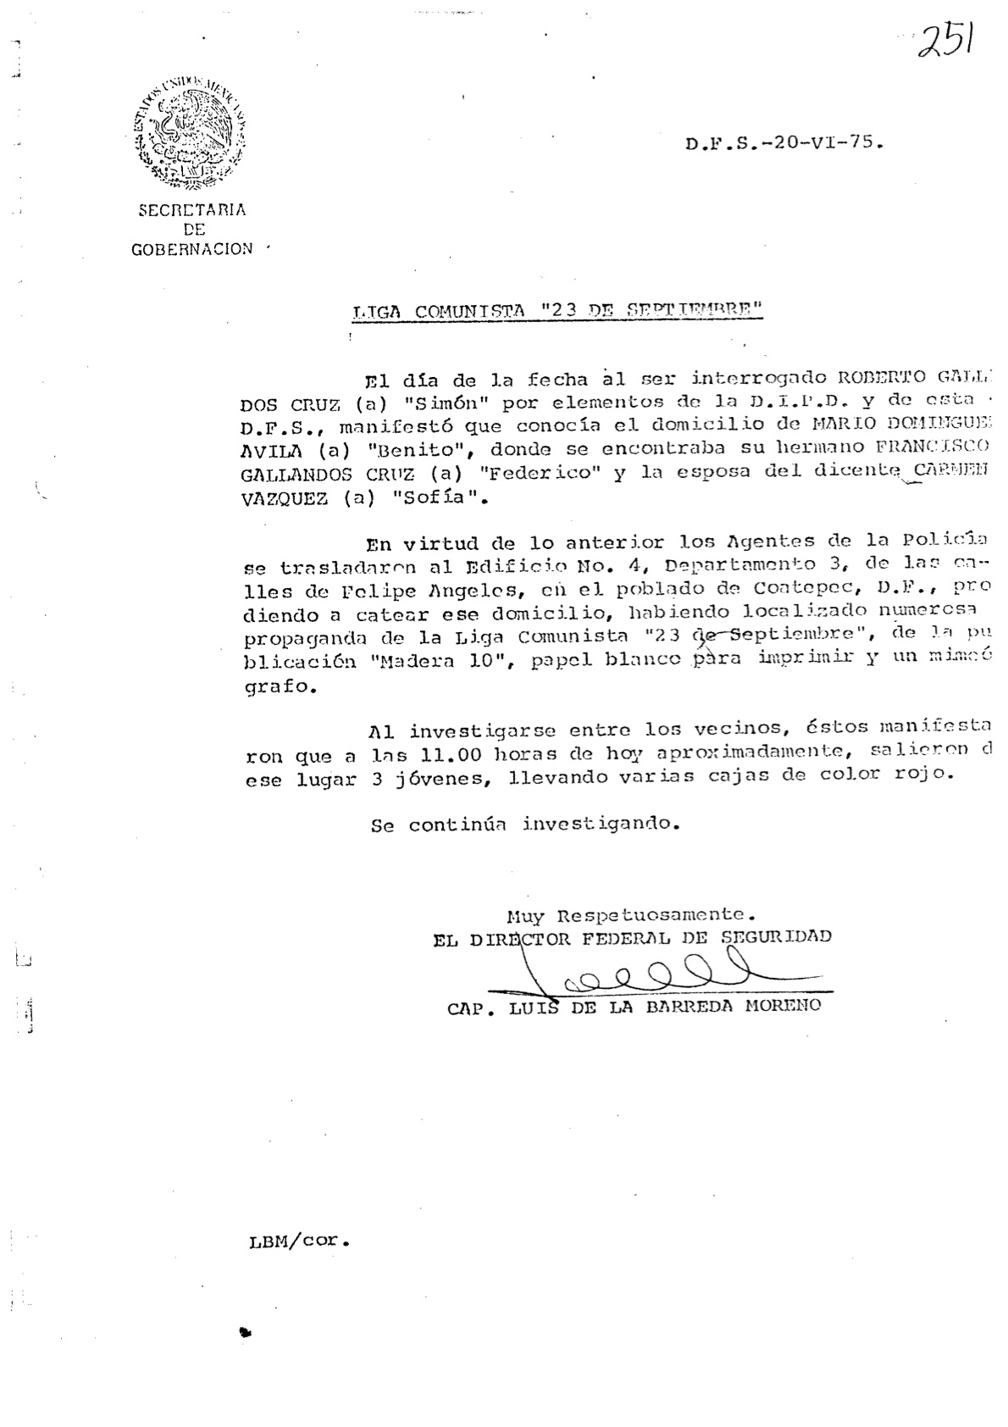
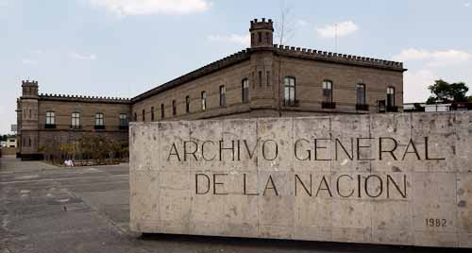
Case Study: Mexico
Federal Directorate of Security, 1947-1985
2002: Records transferred to Archivo General de la Nación

Slide 8
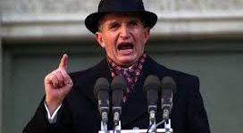
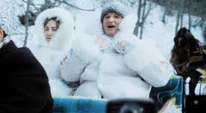
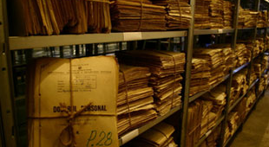
Case Study: Romania

Slide 9
Conclusions
Where are the connections?
Trust
Ethical considerations

Slide 10
Thanks
Joel A. Blanco-Rivera, blancoj@simmons.edu
Katherine M. Wisser, wisser@simmons.edu

