Slide 1
Documenting Detention: Records of Segregation in Two U.S. Prisons
Jarrett M. Drake, M.S.I.
SAA 2013 Research Forum
August 13, 2013

Slide 2
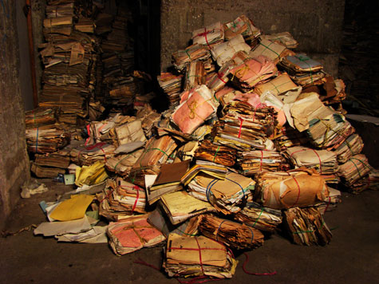
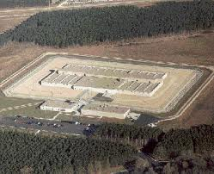
So What?
http://www.utexas.edu/features/2012/01/30/preserving_human_rights/
http://doc.wi.gov/families-visitors/find-facility/wisconsin-secure-program-facility
How do American prisons demonstrate accountability through recordkeeping for instances of inmate segregation?

Slide 3
Methods: Design
Design
Exploratory
Holistic
Multiple
Yin, R. K. (2009)
Case Study Research: Design and Methods, Fourth Edition

Slide 4
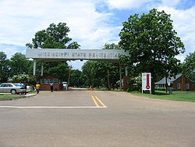
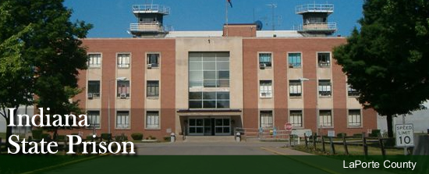
Methods: Units of Analysis
http://www.in.gov/idoc/2413.htm
http://en.m.wikipedia.org/wiki/Mississippi_State_Penitentiary
Factors
Scope
Support
Security

Slide 5
Methods: Data Sources
Data from two streams of evidence: documentation and interviews
Documentation: 1) statutes, 2) administrative codes, 3) retention schedules, and 4) internal policies
Interviews: 15 semi-structured, on-site interviews with staff representing 1) records management, 2) inmate classification, 3) hearings, and 4) custody

Slide 6
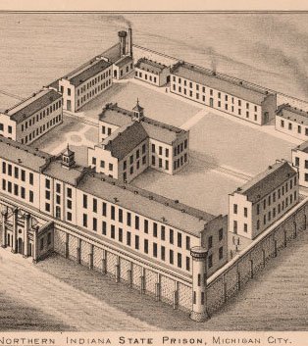
Indiana State Prison: Overview
Est. 1860 in Michigan City, IN
100 acres of land
Level four maximum-security and DR
1,974 inmates
531 employees
http://74.126.224.122/luna/servlet/detail/RUMSEY~8~1~228719~5507768

Slide 7
ISP: Accountability Environment
Indiana Electronic Records Policy, OCPR Policy 12-01
Retention Schedule, Record Series 2007 #04-33: Segregation Unit Records
Indiana Administrative Code, Title 210, Article 1, Rule 6 (Collection, Maintenance, and Release of Offender and Juvenile Records)
Indiana Code, Title 11, Article 11, Chapter 5 (Conduct and Discipline)

Slide 8
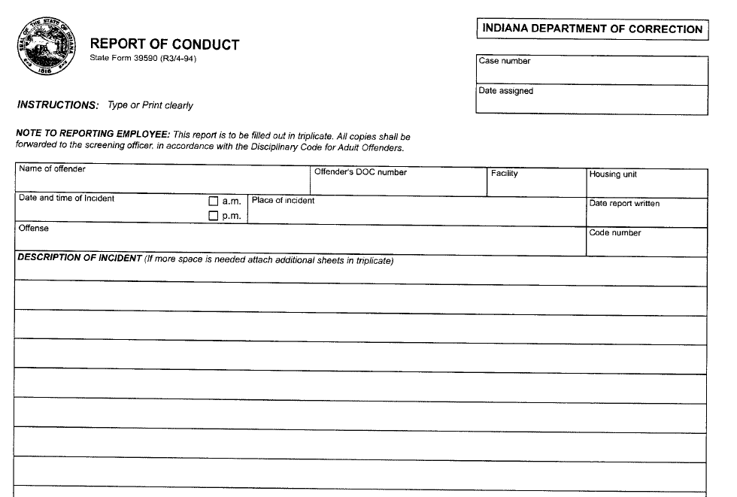
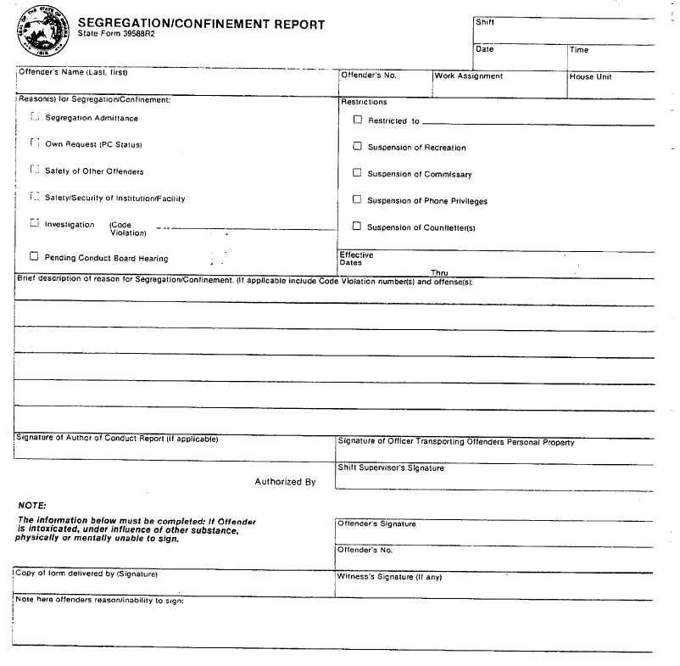
ISP: Recordkeeping Practices
Segregation/Confinement
Report
Conduct Report

Slide 9
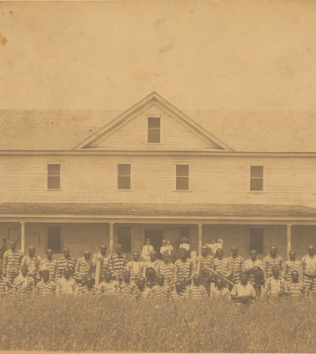
Mississippi State Penitentiary: Overview
Est. 1901 in Parchman, MS
18,000 acres of land
All custody levels and DR
3,338 inmates
986 employees
http://mdah.state.ms.us/arrec/digital_archives/parchman/index.php?id=99010

Slide 10
MSP: Accountability Environment
Records Control Schedule, MDOC #2886-2887
Mississippi Administrative Code, Title 29 Prisons and Parole, Part 1 Administration and Management, Subpart 1 Administration, Part 1 Chapter 5 Records; Part 1 Chapter 12 Management Information Systems
Mississippi Code, Title 47 Prisons and Prisoners, Chapter 5 Correctional System, 10 Department of Corrections Powers & Duties

Slide 11
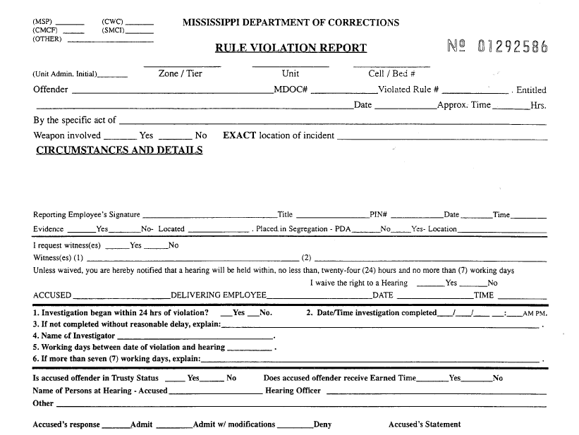
MSP: Recordkeeping Practices
Rule Violation Report
Offender Track Database
Unique login and password
Pre-approved clearance
Access logs

Slide 12
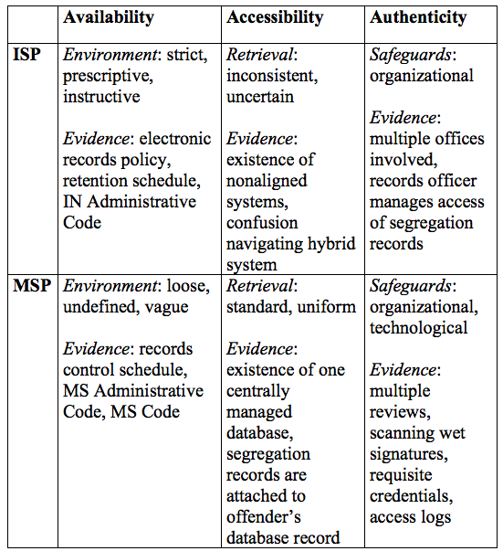
Findings
Stricter accountability environment at ISP did not result in greater accessibility and authenticity
Despite more vague accountability environment, MSP records have increased accessibility and authenticity

Slide 13
Further Research
Examine accountability environment and recordkeeping process of more prisons (other states’ and federal)
Focus on a particular type of inmate segregation, such as solitary confinement
Systematically probe inmates and advocates for experiences with segregation records

Slide 14
Acknowledgements
University of Michigan School of Information
David A. Wallace, PhD
Indiana State Prison
Mississippi State Penitentiary
SAA 2013 Research Forum

