Slide 1
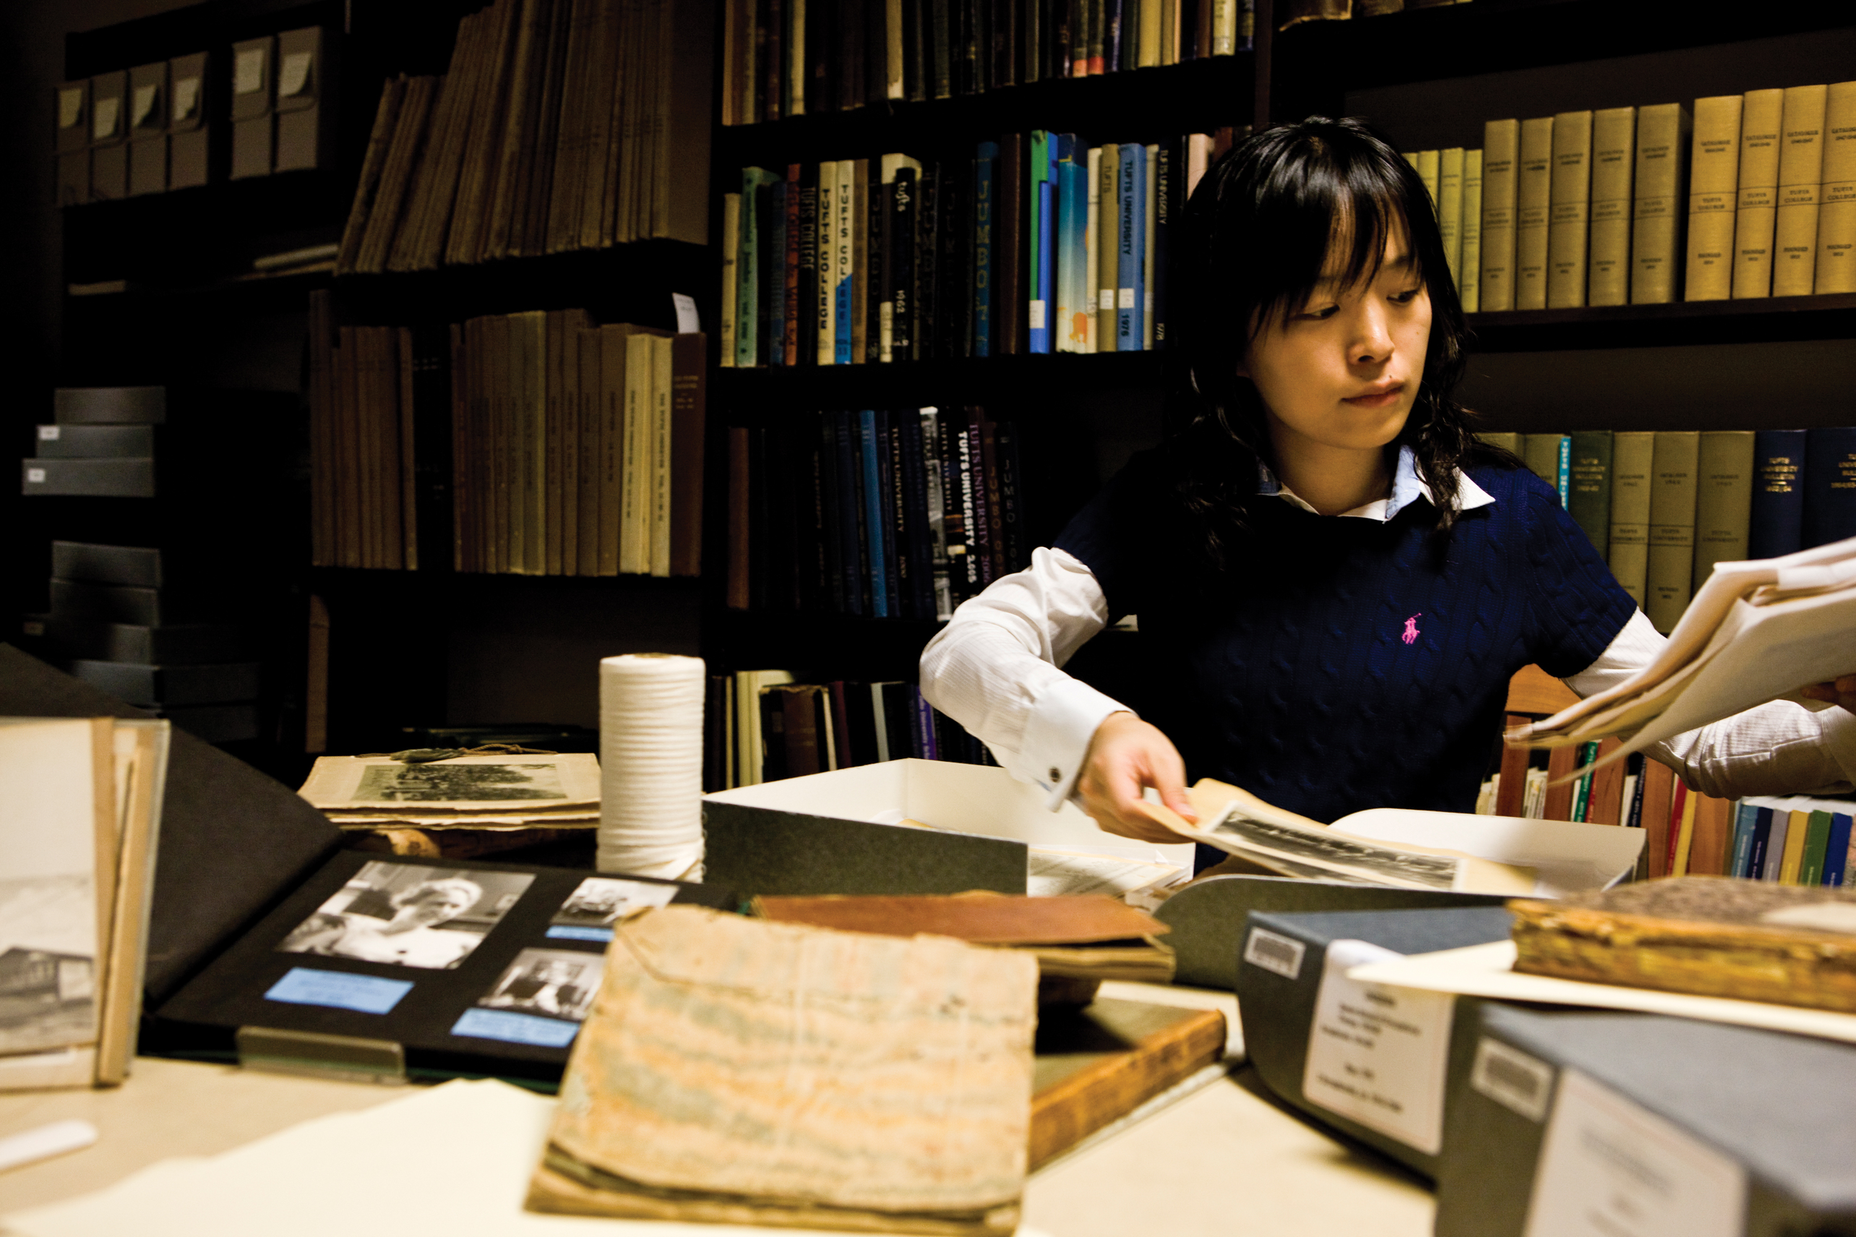
Linked Archival Metadata
Society of American
Archivists
Research Forum
Anne Sauer
Tufts University
August 13, 2013

Slide 2
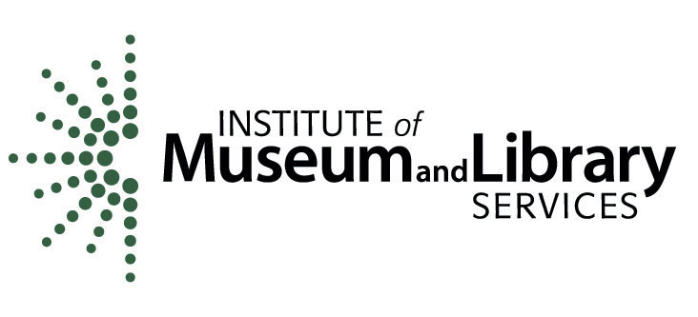
Introducing LiAM
http://go.tufts.edu/liam
Notes:
LiAM is an IMLS-funded National Leadership Grant Planning Project
It is about community – engaging the archival community in linking data. Some archives are doing this, but many are not. There is tremendous value in archives, and we can’t afford to let it sit unlinked.

Slide 3
Greg Colati, University of Connecticut
Karen Gracy, Kent State University
Corey Harper, New York University
Michelle Light, University of Nevada, Las Vegas
Susan Pyzynski, Houghton Library, Harvard University
Aaron Rubinstein, University of Massachusetts, Amherst
Ed Summers, Library of Congress
Ken Thibodeau, NARA (ret.), NIST
Kathy Wisser, Simmons College GSLIS
LiAM
Working Group
Notes:
Get some smart people together. The working group is made up of a lot of very smart people with different areas of expertise and great engagement into the communities we wanted to reach.
Archivists who practice, with different kinds of collections.
Archivists who teach future archivists
Archivists who are technologists
Technologists who work with archivists

Slide 4
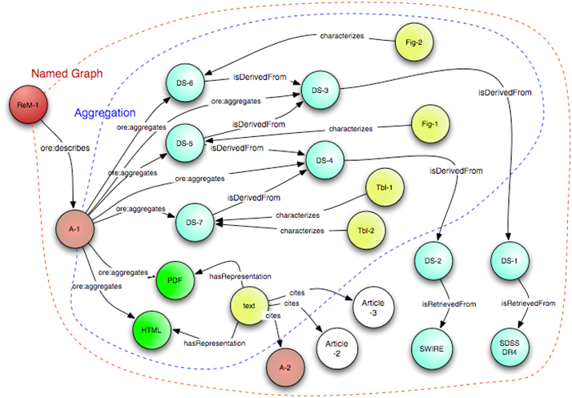

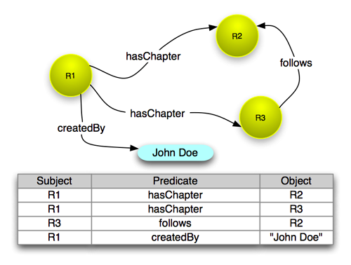
Whence LiAM?
OAI-ORE
Notes:
Struck that what OAI-ORE was trying to do for web collections was basically what archives were trying to do with finding aids.
So, let’s look at finding aids for a moment.

Slide 5
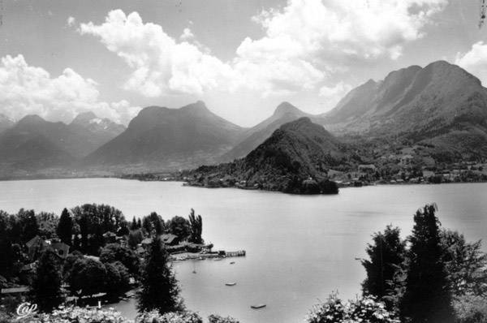
A Whole New Landscape
Notes:
Lots of LOD happening.
We saw value in the idea of linked data as helping to address some of these issues of access and use. At the same time LOD has been a vibrant and actively evolving field of inquiry for the LAM community. We knew that whatever we tried to do, we needed to leverage what was already going on and not reinvent the wheel.

Slide 6
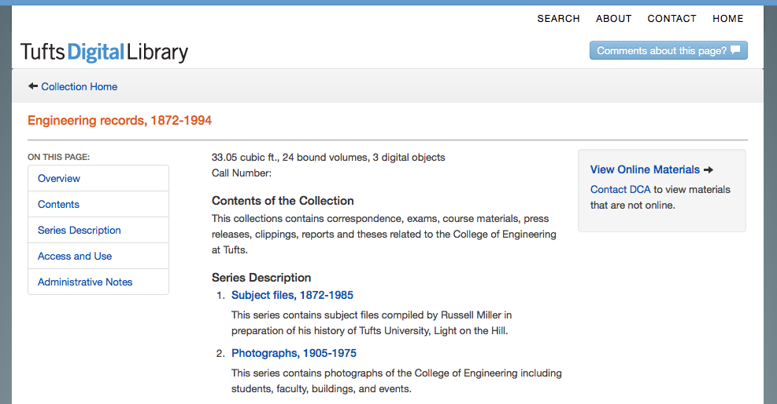
Old Tools in a New World: The Finding Aid
Notes:
Problem is that we need more flexibility. It’s cumbersome to do some of those things in a finding aid, especially in modern collections that are huge and where arrangement is problematic.
Finding aids were developed at a time when paper was king. Cross referencing through see references and subject terms help to cut across finding aids, but they are, for the most part, conceived as self-contained documents that stand on their own and are designed to be read and understood as part of the research process.
Finding aids are on the web, but not always, and not always published in a way that facilitates linking

Slide 7
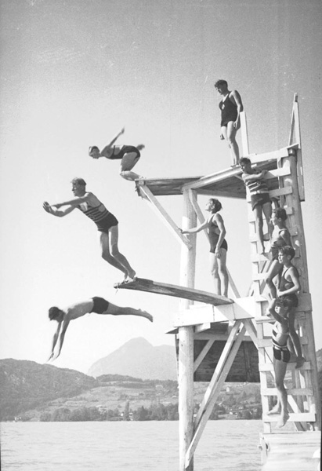
Finding Aid Strengths
Hierarchy
Notes:
Finding aids have many strengths:
Hierarchy enables users to survey the landscape before delving into the forest. In a finding aid, you choose when to dive into the trees and when to sail over the canopy.
Finding
Convey archivist knowledge of the collection – this is not to be belittled. The processing archivist gains valuable insight while processing a collection insight into context and meaning that comes from seeing and understanding the collection as a whole

Slide 8
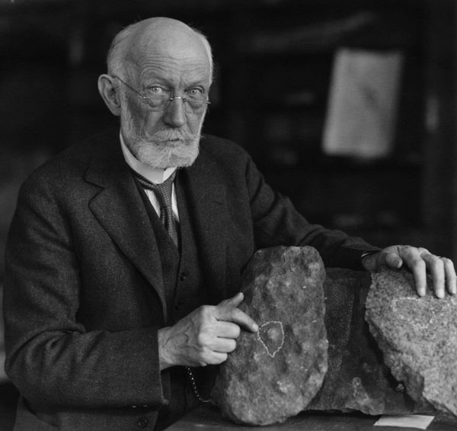
Finding Aid Strengths
Archivist Expertise
Notes:
Venue for archivist knowledge.
Convey archivist knowledge of the collection – this is not to be belittled. The processing archivist gains valuable insight while processing a collection insight into context and meaning that comes from seeing and understanding the collection as a whole

Slide 9
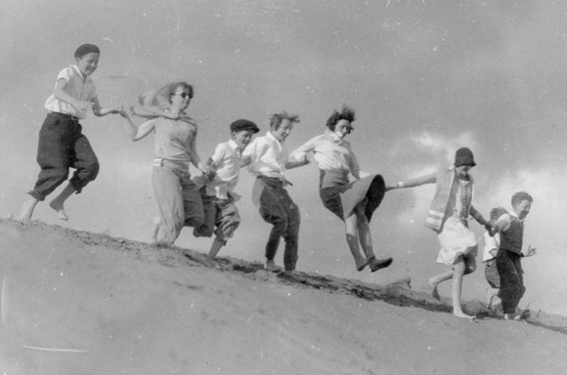
Working
Group
Meeting
December
2012
Day 1: Understanding Challenges
Notes:
2 days
Day 1 :hashed through use cases and shared perspectives on LOD. Where are we now, and how does active LOD work relate to archives? Does it?
Identified several issues: General perception that LOD is perceived as being out of reach for many archivists
Not clear what tangible benefits are
Not really clear what it is
Not really clear how to do it
Given all that, how can we divert resources from backlog, appraisal, reference for LOD?
Generally: LOD is a cool thing that the big archives with developers are doing, but it’s not something we can do.
From the tech side – proliferation of creative ideas and exciting projects that don’t always take archivists concerns at the center. Some LOD people are archivists, but some are not
US/THEM dichotomy

Slide 10
Step One:
Use Cases
Identify challenges
Describe needs
Real-world examples
Notes:
Not about our work, this is about cases where we felt that we were not adequately exposing information about our collections in meaningful ways for users.

Slide 11
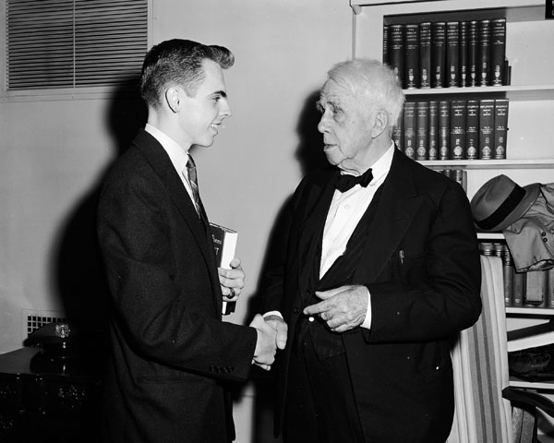
Linking Across Repositories:
Robert Frost
Notes:
MSS from Library of Congress, photo from Tufts
SNAC is an example of LOD solution to this problem
Social Networks and Archival Context

Slide 12
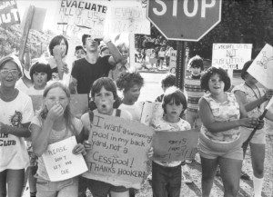
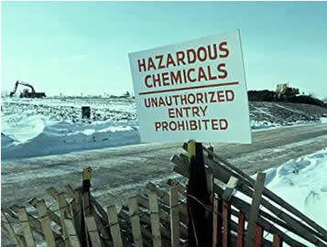
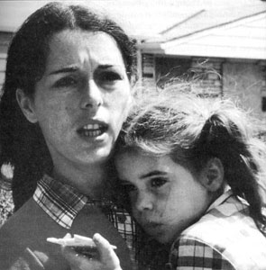
Documenting an Event
Love Canal

Slide 13
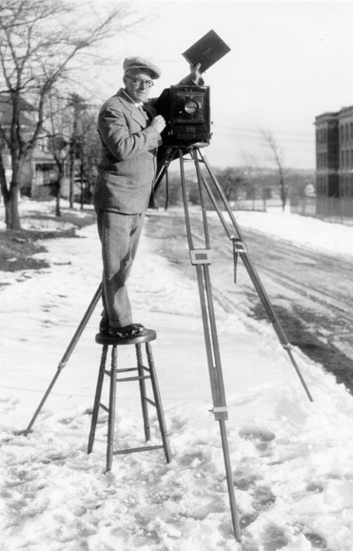
One Person, Many Roles
Notes:
Associate Provost
Alumna (graduate and undergraduate)
Clinical faculty
Regular faculty
Private practice at hospital
Dean for faculty affairs
Associate Provost
PI on grants

Slide 14
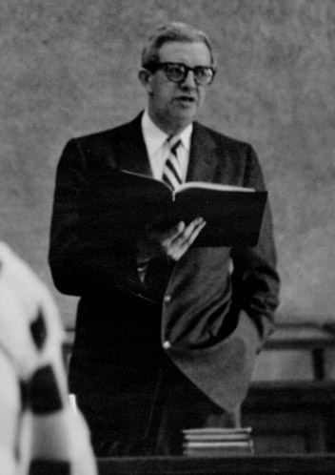
Documenting a Course
Notes:
Records in many places:
Department files
Course catalogs
Course evaluations
Curriculum Committee
Faculty papers
Student portfolios

Slide 15
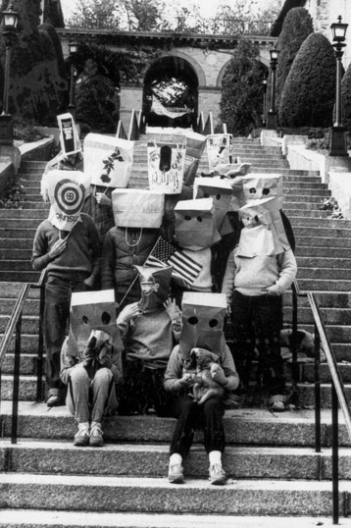
Documenting Underdocumented
Communities
Notes:
What about communities where records are scattered and poorly kept?

Slide 16
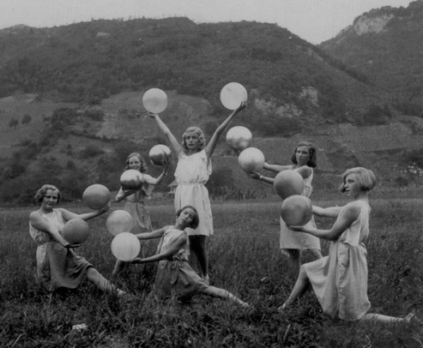
Make Connections
Find
Balance
Leverage Existing Description
Notes:
Balance?
There is real value in archival theory, and it cannot be discarded.
At the same time, there is a need to fulfill the needs of theory while enabling users to make the connections that they need to make across our collections.

Slide 17
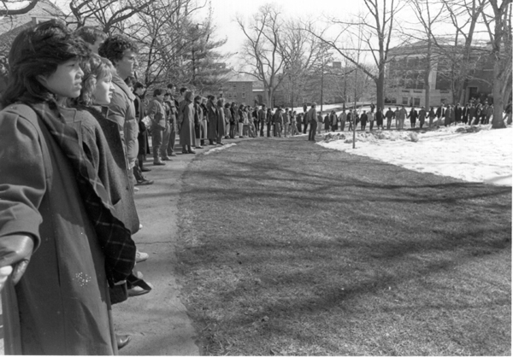
Working Group Meeting
December 2012
Day 2:
What can we do?
Notes:
2 days
Chance to digest Day 1 discussions. What can we do, what would be useful?

Slide 18
Goals
Address varied audiences
Describe landscape
Ground in real world examples
Focus on graduated approaches
Identify gaps/needs
Flexible format
Notes:
Audiences:
Archivists who don’t know anything about LOD
Archivists who are doing LOD
Technologists who are doing LOD

Slide 19
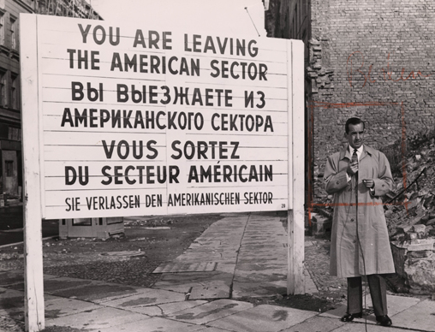
Linked Archival Metadata:
A Guidebook
Notes:
Translate LOD and help navigate a minefield of opportunities

Slide 20
Guidebook Outline
1. Executive Summary
2. Introduction
3. Linked Data for Archives: a Primer
4. Linked Data Today
5. Getting Started: Strategies and Steps
6. On Your Way: Next Steps
7. Looking Ahead: Advanced Tools and Visualizations
Notes:
1. Executive Summary
2. Introduction
a. Why linked data, and why now?
b. How to use the Guidebook
3. Linked Data for Archives: a Primer
a. Objectives: management, access, and use and linked data affordances
b. Overview of linked data concepts and vocabulary
c. Brief overview of the history of LOD-LAM
d. Examples
4. Linked Data Today
a. Projects: Brief descriptions with an emphasis on tangible benefits and outcomes of each
b. Trends in LOD-LAM
5. Getting Started: Strategies and Steps
a. Defining your strategy: Articulate goals, objectives, and metrics to measure success.
b. Is your archival description LOD-ready?
c. Identify building blocks: metadata components in archival description that are (or nearly are) ready for linking.
d. Readiness: Making small changes in practice to make your description LOD-ready.
e. What you can do now if you have:
i. EAD
ii. EAC-CPF
iii. MARC
iv. METS, MODS, and perhaps more. This section will provide illustrative examples of what can be done with the linked data building blocks already included in archival description
6. On Your Way: Next Steps
a. Integration into daily practice
b. Three Cs: Cleanup, Conversion, Consistency
c. Tools
7. Looking Ahead: Advanced Tools and Visualizations
a. Tools for archivists (data preparation, cleanup, management)
i. What’s available now
ii. Gaps: What is needed
b. Tools for users (visualizations, interfaces)
i. What’s available now
ii. Gaps: What is needed

Slide 21
Guidebook Timeline
Consultant Hired
Early Draft October 2013
Community comments/revisions
Final Draft: March 31, 2014

Slide 22
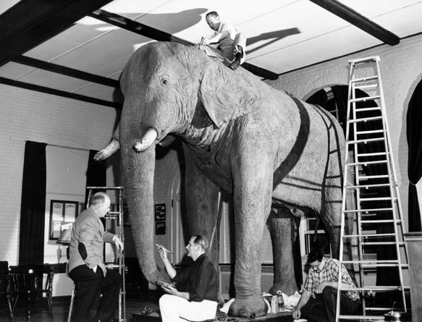
Challenges
Notes:
Even before we have a draft of the Guidebook, we can see the sticking points for getting archives into LOD-Land

Slide 23
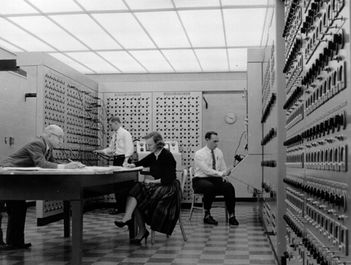
Technology
Notes:
And it isn’t the technology.

Slide 24
Linked Data requires consistency

Slide 25
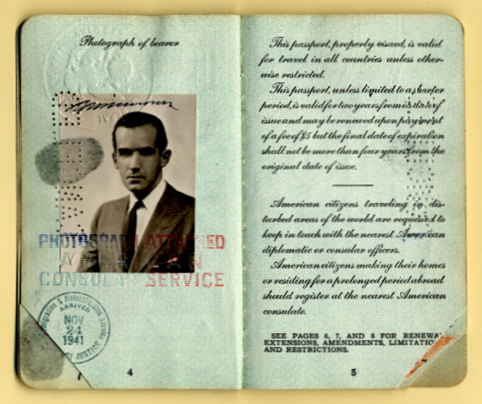
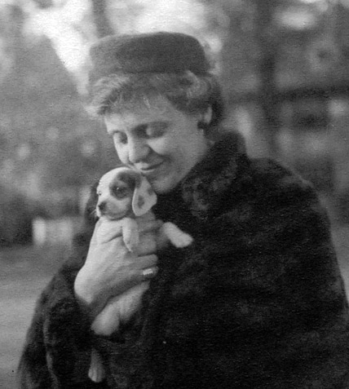
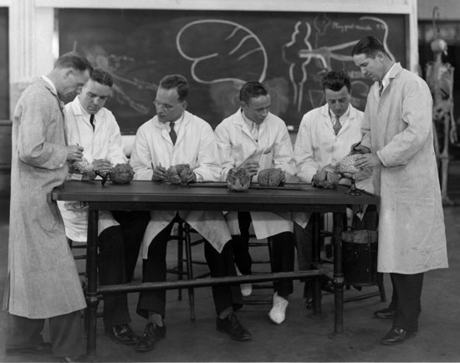
In a world where everything is special …
Notes:
And backlogs discourage going back to redo/update/migrate description
Too strong a tradition of local practices that don’t conform

Slide 26
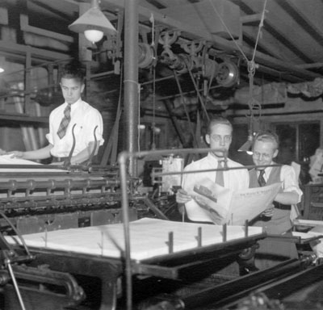
Standards
Standards
Standards
Not “sort of”
Not “sometimes”
Not “except”
Standards, period.
Notes:
It doesn’t matter which one you choose, but follow it consistently
If this is going to work, archivists have to start following standards, for real.

Slide 27
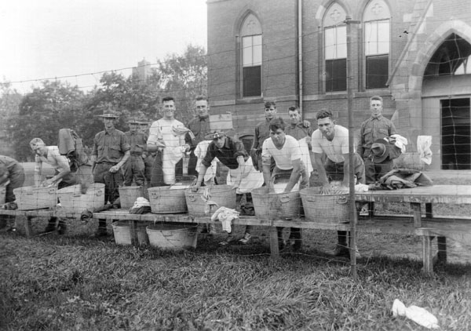
Data Cleanup
Notes:
This is going to be a major challenge. We are already seeing it in the early LOD projects in this space: SNAC, NAAC,
DPLA. Ask anyplace that is engaged in harvesting metadata. We’re all using the right structures, but the content we’re populating with is not consistent.

Slide 28
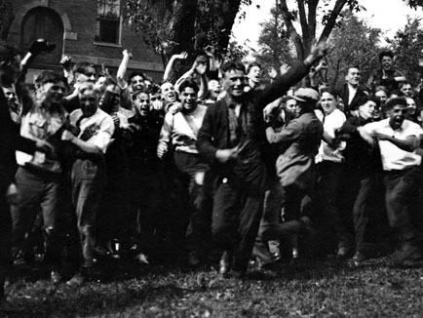
From Challenges to Opportunities
LiAM Open Meeting
Aug. 14, 1pm, Ascot Room
Notes:
Huge opportunities:
Exposing archives so more people can use them.
Flexible approaches to description – this is the most exciting opportunity I see – actually integrating a linked data concepts into the arrangement and descriptive process. Instead of thinking of writing our description as finding aids, think about describing connections between records and context and then making sure that a finding aid is one available map of a collection. But one among many.

Slide 29
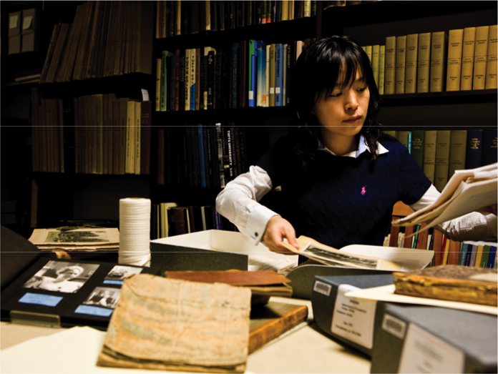
Thank you!
LiAM
http://go.tufts.edu/liam
anne.sauer@tufts.edu
http://dca.tufts.edu/
Xu Cheng
Digital Collections and Archives reading room
Tufts University
2008

