Slide 1
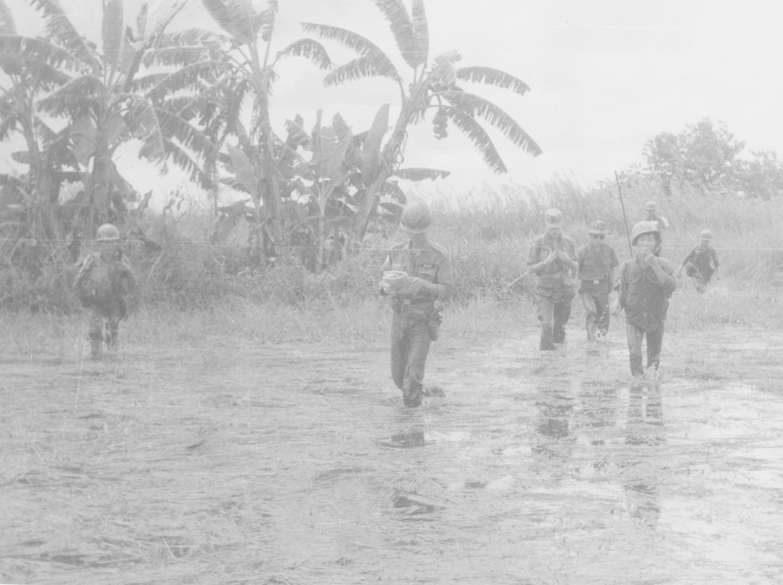
The Wicked Problem of Documenting
Armed Conflict
An Analysis of US Advisor Province Reports in the
Vietnam War
Eliot Wilczek Simmons College | Tufts University
SAA 2013 Research Forum New Orleans August 13, 2013

Slide 2
The Wicked Problem of Documenting Armed Conflict
Eliot Wilczek SAA 2013 Research Forum
Introduction
Methodology
Frameworks &
Wicked Problems
Images
Overview
Dissertation Proposal
In Progress
How organizations document complex environments
Case Study
Monthly province reports
US province advisors
Vietnam War
Notes:
Eliot Wilczek
Doctoral student, Simmons
RM, Tufts

Slide 3
The Wicked Problem of Documenting Armed Conflict
Eliot Wilczek SAA 2013 Research Forum
Introduction
Methodology
Frameworks &
Wicked Problems
Images
Historical Background
US combat troops
&
US advisors
Peek combat troops level | 540,000 1968
Peak advisor level | 7,600 1969
Civilian and advising effort managed by
array of US civilian agencies &
military commands
CORDS
Civilian Operations and Revolutionary Development Support
Various Advisor Types | Province Advisors
Notes:
Eliot Wilczek
Doctoral student, Simmons
RM, Tufts

Slide 4
The Wicked Problem of Documenting Armed Conflict
Eliot Wilczek SAA 2013 Research Forum
Introduction
Methodology
Frameworks &
Wicked Problems
Images
Advisor Recordkeeping Ecology
Significant reporting responsibilities
30+ monthly reports
65+ reports overall
Notes:
Eliot Wilczek
Doctoral student, Simmons
RM, Tufts

Slide 5
The Wicked Problem of Documenting Armed Conflict
Eliot Wilczek SAA 2013 Research Forum
Introduction
Methodology
Frameworks &
Wicked Problems
Images
Monthly Province Reports
Capstone monthly report at province level combating insurgency in South Vietnam
Report Rules
MACV Joint Directive 4-67
MACV Joint Directive 2-69
MACV Joint Directive 4-70
Notes:
Eliot Wilczek
Doctoral student, Simmons
RM, Tufts

Slide 6
The Wicked Problem of Documenting Armed Conflict
Eliot Wilczek SAA 2013 Research Forum
Introduction
Methodology
Frameworks &
Wicked Problems
Images
Monthly Province Reports
Reported delivered every month
CORDS Regional HQ
CORDS HQ (Saigon)
MACV HQ (Saigon/San Francisco)
Department of Defense / White House
Notes:
Eliot Wilczek
Doctoral student, Simmons
RM, Tufts

Slide 7
The Wicked Problem of Documenting Armed Conflict
Eliot Wilczek SAA 2013 Research Forum
Introduction
Methodology
Frameworks &
Wicked Problems
Images
Research Questions
Overarching Question
How do organizations document complex environments?
Notes:
Eliot Wilczek
Doctoral student, Simmons
RM, Tufts

Slide 8
The Wicked Problem of Documenting Armed Conflict
Eliot Wilczek SAA 2013 Research Forum
Introduction
Methodology
Frameworks &
Wicked Problems
Images
Research Questions
Supporting Operational Questions
What did the rules for creating monthly province reports ask US province advisors to document?
What did US advisors actually document in these monthly province reports?
What was the difference between the prescribed and actual creation of these monthly province reports?
How did the monthly province reports shape US province advisors' representation of the war?
Notes:
Eliot Wilczek
Doctoral student, Simmons
RM, Tufts

Slide 9
The Wicked Problem of Documenting Armed Conflict
Eliot Wilczek SAA 2013 Research Forum
Introduction
Methodology
Frameworks &
Wicked Problems
Images
Case Study
50 Province Reports
January 1969 – February 1973
Single Province
Phong Dinh
Notes:
Eliot Wilczek
Doctoral student, Simmons
RM, Tufts

Slide 10
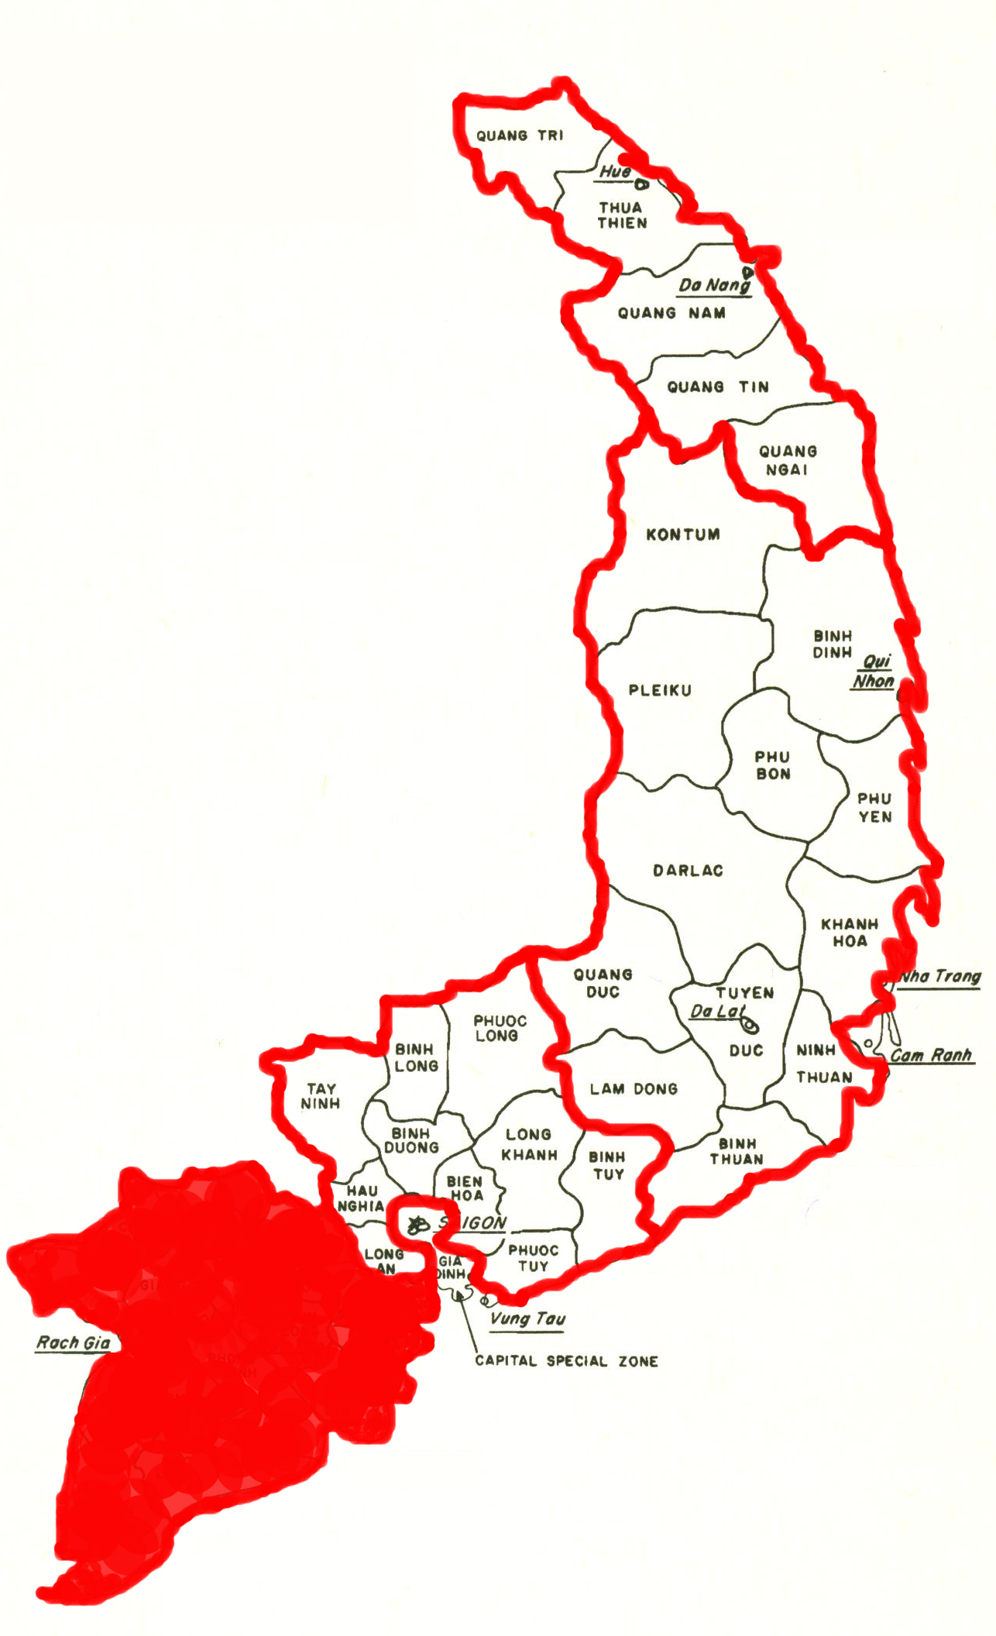
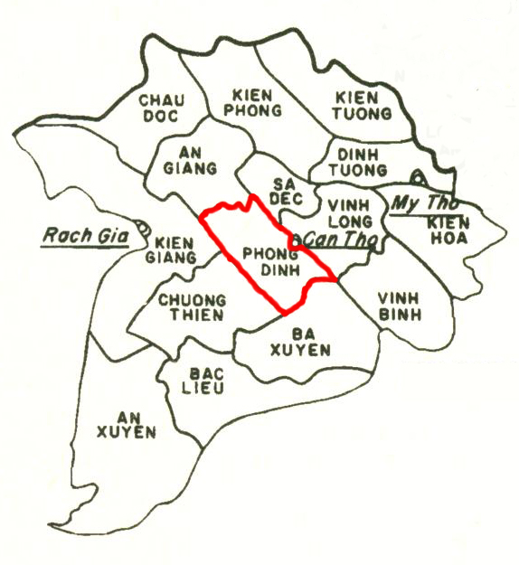
The Wicked Problem of Documenting Armed Conflict
Eliot Wilczek SAA 2013 Research Forum
Introduction
Methodology
Frameworks &
Wicked Problems
Images
Case Study
South
Vietnam
Phong Dinh in Geographical Context
I Corps
II Corps
III Corps
IV Corps
Phong Dinh
IV Corps
Notes:
Eliot Wilczek
Doctoral student, Simmons
RM, Tufts

Slide 11
The Wicked Problem of Documenting Armed Conflict
Eliot Wilczek SAA 2013 Research Forum
Introduction
Methodology
Frameworks &
Wicked Problems
Images
Case Study
Population
Not sample of all province reports
Transferrable lessons for
theory & frameworks
Not generalizable to broader population
Notes:
Eliot Wilczek
Doctoral student, Simmons
RM, Tufts

Slide 12
The Wicked Problem of Documenting Armed Conflict
Eliot Wilczek SAA 2013 Research Forum
Introduction
Methodology
Frameworks &
Wicked Problems
Images
Content Analysis
Object of Study
50 Province Reports
Codebook developed
Literature &
Iterative examination of reports
Unit of coding
Province Report Sentences
Notes:
Eliot Wilczek
Doctoral student, Simmons
RM, Tufts

Slide 13
The Wicked Problem of Documenting Armed Conflict
Eliot Wilczek SAA 2013 Research Forum
Introduction
Methodology
Frameworks &
Wicked Problems
Images
Content Analysis
Research technique for making replicable and valid inferences from texts (or other meaningful matter) to the contexts of their use.
Klaus Krippendorff, Content Analysis, An Introduction to Its Methodology, 3rd ed. (Sage: Los Angeles) 2013.
Notes:
Eliot Wilczek
Doctoral student, Simmons
RM, Tufts

Slide 14
The Wicked Problem of Documenting Armed Conflict
Eliot Wilczek SAA 2013 Research Forum
Introduction
Methodology
Frameworks &
Wicked Problems
Images
Content Analysis
Communicated content
Creator & Recipient
Researcher brings
analytical framework to texts
Notes:
Eliot Wilczek
Doctoral student, Simmons
RM, Tufts

Slide 15
The Wicked Problem of Documenting Armed Conflict
Eliot Wilczek SAA 2013 Research Forum
Introduction
Methodology
Frameworks &
Wicked Problems
Images
Codebook
Structure
Report Sections
Notes:
Eliot Wilczek
Doctoral student, Simmons
RM, Tufts

Slide 16
The Wicked Problem of Documenting Armed Conflict
Eliot Wilczek SAA 2013 Research Forum
Introduction
Methodology
Frameworks &
Wicked Problems
Images
Codebook
Content
Entities
Insurgents / GVN / Civilian / US / None
Notes:
Eliot Wilczek
Doctoral student, Simmons
RM, Tufts

Slide 17
The Wicked Problem of Documenting Armed Conflict
Eliot Wilczek SAA 2013 Research Forum
Introduction
Methodology
Frameworks &
Wicked Problems
Images
Codebook
Content
Entities
Insurgents / GVN / Civilian / US / None
Focused Topics: Entities
Insurgents / Civilians
Focused Topics: Programs
Chieu Hoi / Phoenix / RF & PF
Notes:
Eliot Wilczek
Doctoral student, Simmons
RM, Tufts

Slide 18
The Wicked Problem of Documenting Armed Conflict
Eliot Wilczek SAA 2013 Research Forum
Introduction
Methodology
Frameworks &
Wicked Problems
Images
Wicked Problems
societal challenges
complex
vitally important
ill defined
“rely upon elusive political judgment
for resolution.”
Horst W. J. Rittel and Melvin M. Webber, “Dilemmas in a General Theory of Planning,” Policy Sciences 4 (1973): 155–169.
Notes:
Eliot Wilczek
Doctoral student, Simmons
RM, Tufts

Slide 19
The Wicked Problem of Documenting Armed Conflict
Eliot Wilczek SAA 2013 Research Forum
Introduction
Methodology
Frameworks &
Wicked Problems
Images
Wicked Problems
Describing
closely tied to
conceptualizing
problems
Measured indicators
closely linked
perceived sources of
problems/solutions.
Conceptualization of an insurgency
shapes how it is measured.
Notes:
Eliot Wilczek
Doctoral student, Simmons
RM, Tufts

Slide 20
The Wicked Problem of Documenting Armed Conflict
Eliot Wilczek SAA 2013 Research Forum
Introduction
Methodology
Frameworks &
Wicked Problems
Images
Programs not People
1. Overall Status of the Pacification Effort
2. Priority Pacification Programs
a. Improve Territorial Security
(1) Enemy Situation
(2) Friendly Situation
(3) Status of RF/PF
(4) Status of National Police
b. Protect the People from Terrorism
c. Improve and Expand PSDF
d. Improve Local Administration
e. Greater National Unity
f. Brighter Life for War Victims
g. People's Information
h. Prosperity for All
3. Future Problems and Projections
4. Required Actions
Section Headers
Monthly Province Report
Phong Dinh Province
February 1970
Notes:
Eliot Wilczek
Doctoral student, Simmons
RM, Tufts

Slide 21
The Wicked Problem of Documenting Armed Conflict
Eliot Wilczek SAA 2013 Research Forum
Introduction
Methodology
Frameworks &
Wicked Problems
Images
Political Actors
Self-interest of advisors
"In many instances they [monthly province reports] appear to be justifications for the existence of the advisory team rather than an information document of the entire effort.”
Delta Military Assistance Command, Headquarters
CORDS IV Corps Directive No. 73-69
Monthly Province Reports
14 May 1969
Notes:
Eliot Wilczek
Doctoral student, Simmons
RM, Tufts

Slide 22
The Wicked Problem of Documenting Armed Conflict
Eliot Wilczek SAA 2013 Research Forum
Introduction
Methodology
Frameworks &
Wicked Problems
Images
Conceptualization of War
Internal logic of US & GVN
ill-suited for the war
James Gibson
The Perfect War:
Technowar in Vietnam
Jeffery Race
War Comes to Long An:
Revolutionary Conflict in a
Vietnamese Province
Notes:
Eliot Wilczek
Doctoral student, Simmons
RM, Tufts

Slide 23
The Wicked Problem of Documenting Armed Conflict
Eliot Wilczek SAA 2013 Research Forum
Introduction
Methodology
Frameworks &
Wicked Problems
Images
Significance
Wicked problems as a
conceptual frame for
study of recordkeeping behavior
Conceptualization of problems
as factor shaping
recordkeeping behavior
Notes:
Eliot Wilczek
Doctoral student, Simmons
RM, Tufts

Slide 24
The Wicked Problem of Documenting Armed Conflict
Eliot Wilczek SAA 2013 Research Forum
Introduction
Methodology
Frameworks &
Wicked Problems
Images
Significance
Iraq and Afghanistan Wars
International Aid / Post-conflict societies
Measuring inputs vs outputs
Notes:
Eliot Wilczek
Doctoral student, Simmons
RM, Tufts

Slide 25
The Wicked Problem of Documenting Armed Conflict
Eliot Wilczek SAA 2013 Research Forum
Introduction
Methodology
Frameworks &
Wicked Problems
Images
Research Questions
Supporting Operational Questions
What did the rules for creating monthly province reports ask US province advisors to document?
What did US advisors actually document in these monthly province reports?
What was the difference between the prescribed and actual creation of these monthly province reports?
Results Chapter
Content Analysis Data
Notes:
Eliot Wilczek
Doctoral student, Simmons
RM, Tufts

Slide 26
The Wicked Problem of Documenting Armed Conflict
Eliot Wilczek SAA 2013 Research Forum
Introduction
Methodology
Frameworks &
Wicked Problems
Images
Research Questions
Supporting Operational Questions
How did the monthly province reports shape US province advisors' representation of the war?
Discussion Chapter
How do organizations document
complex environments?
Frameworks of
Recordkeeping Behavior
Assessment & Evaluation
Wicked Problems
Notes:
Eliot Wilczek
Doctoral student, Simmons
RM, Tufts

Slide 27
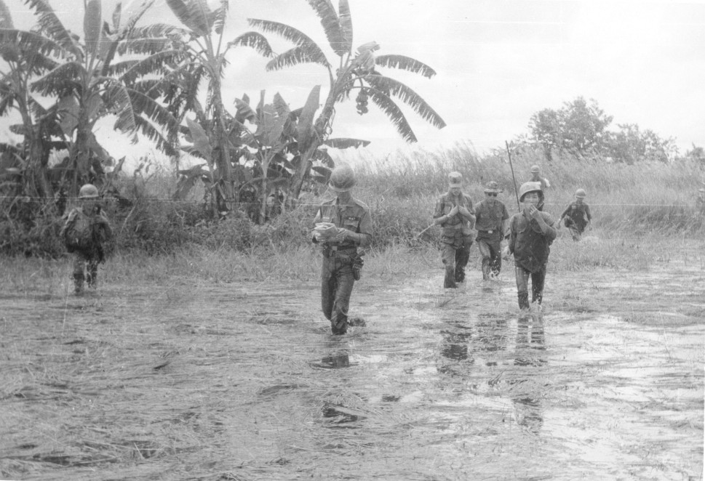
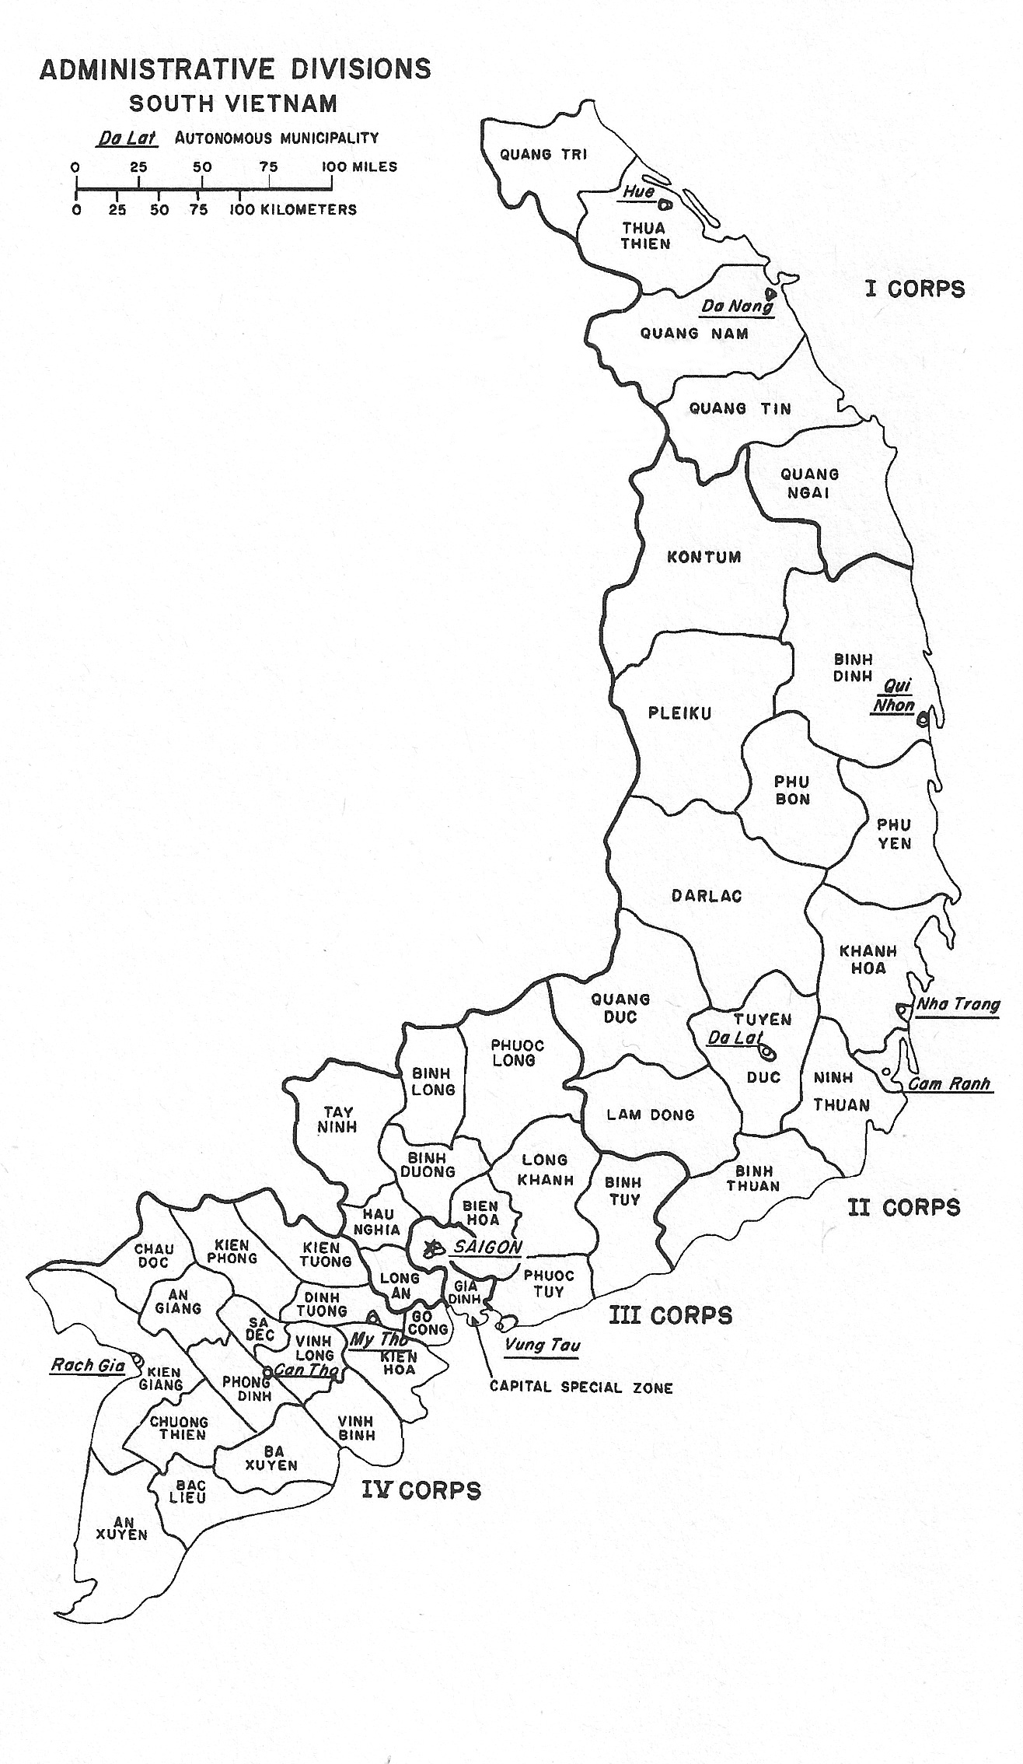
The Wicked Problem of Documenting Armed Conflict
Eliot Wilczek SAA 2013 Research Forum
Introduction
Methodology
Frameworks &
Wicked Problems
Images
Vietnamese soldiers with American advisor in IV Corps in 1970. Photograph VA035028, No Date, Van Michael Davidson Collection, The Vietnam Center and Archive, Texas Tech University. http://www.vietnam.ttu.edu/virtualarchive/items.php?item=VA035028
US Army, 1975. Reproduced in Nick Turse, Kill Anything That Moves: The Real American War in Vietnam (New York: Metropolitan Books, 2013).

